Slide 1
Product Presentation for
ELEVATE BUILDING PROJECTS PTY LTD
Reference No.
444511196
Created Date
6th December 2024
Prepared by
MICHELLE SINCLAIR
Valid Until
6th January 2025
Branch
Plumbing Bundaberg (07) 4339 2510

Slide 2
Your Reece Contact
MICHELLE SINCLAIR
Plumbing Bundaberg
16 Lillian Crescent
Kensington
Phone
(07) 4339 2510
Email
bundaberg.showroom.qld@reece.com.au
Quote Number
444511196
Valid Until
6th January 2025
reece.com.au
This document is created for presentation purposes only as a customer courtesy. It is not an official Reece quote or sales document. Any price shown apply only to the corresponding Reece quote. Products listed are available for purchase at time of printing. Please contact the branch listed on this presentation for more information.

Slide 3
---KITCHEN--

Slide 4
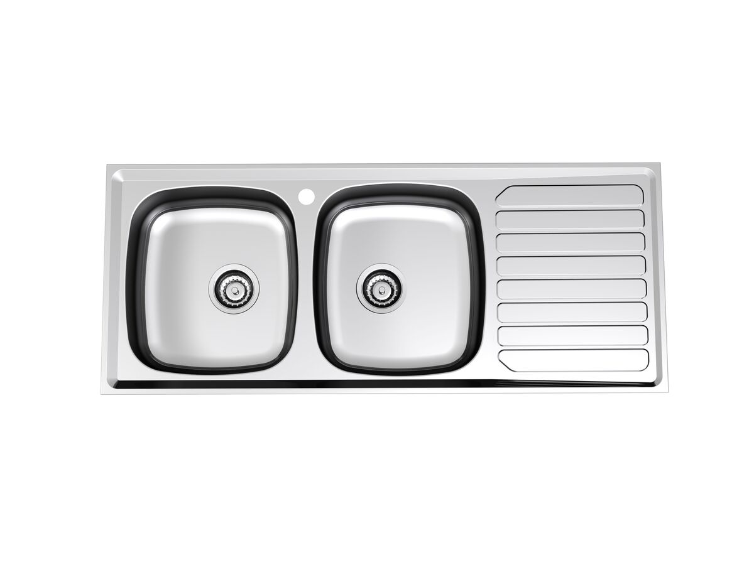
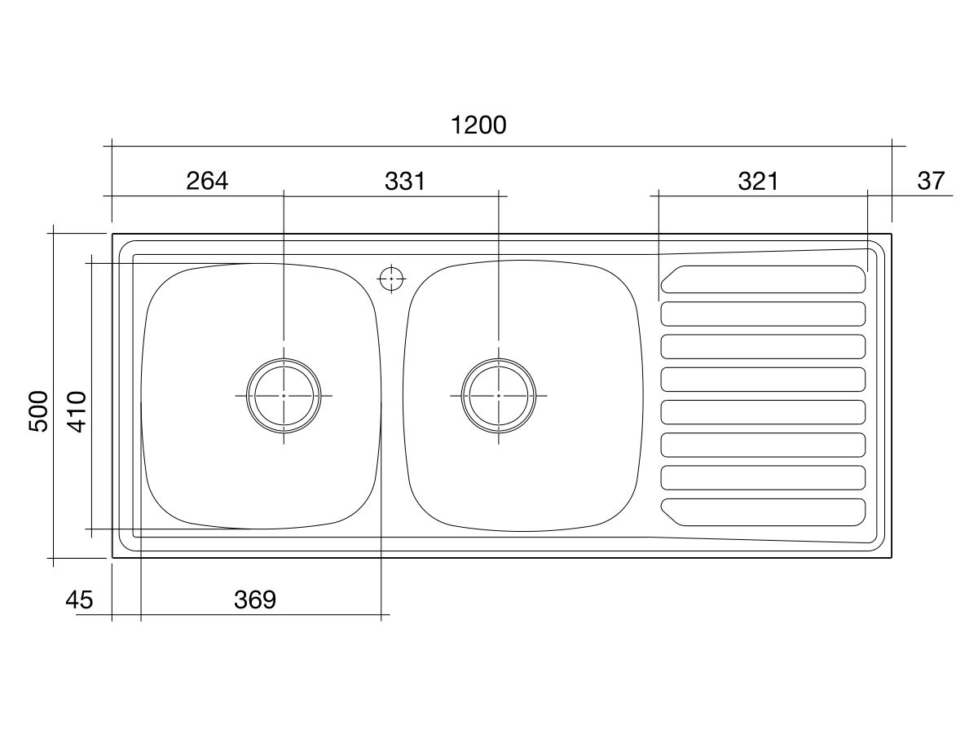
Presentation of Quote 444511196
Base MkII Double Bowl Sink 1th Lhb S/S
Product Code:
2000156
Warranty:
Warranty - Domestic Use: 7 Years Warranty Information: For full warranty terms and conditions please refer to the Base Warranty document Warranty - Commercial Use: 12 Months Spare Parts and Labour: 12 Months
Valid Until 6th January 2025
All images are for illustration purposes only - not for construction. Colours & Sizes can vary & may be subject to change

Slide 5
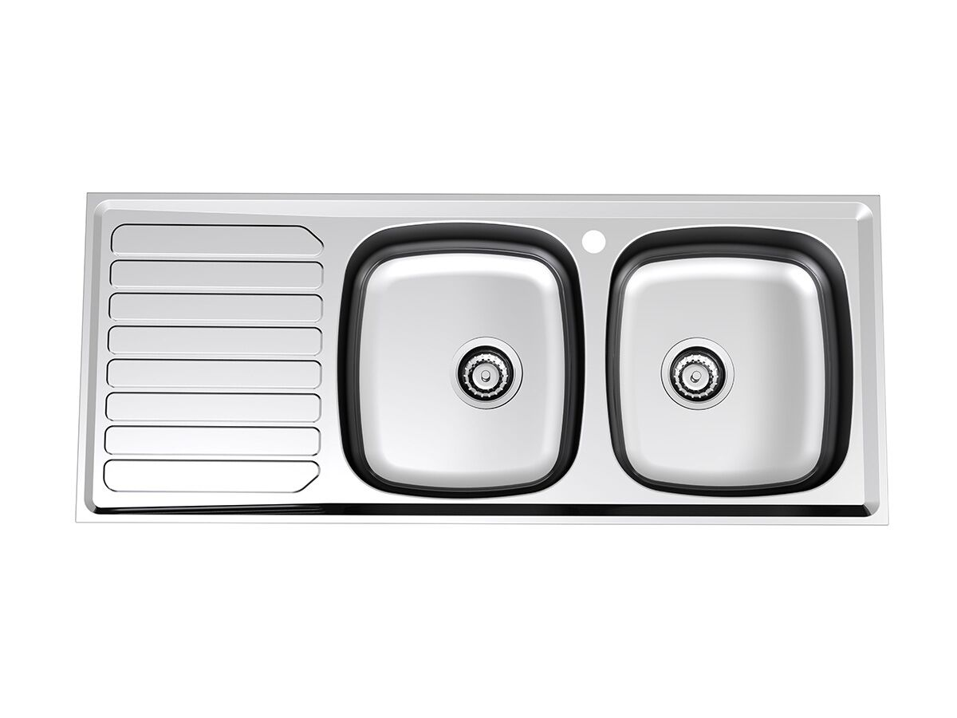
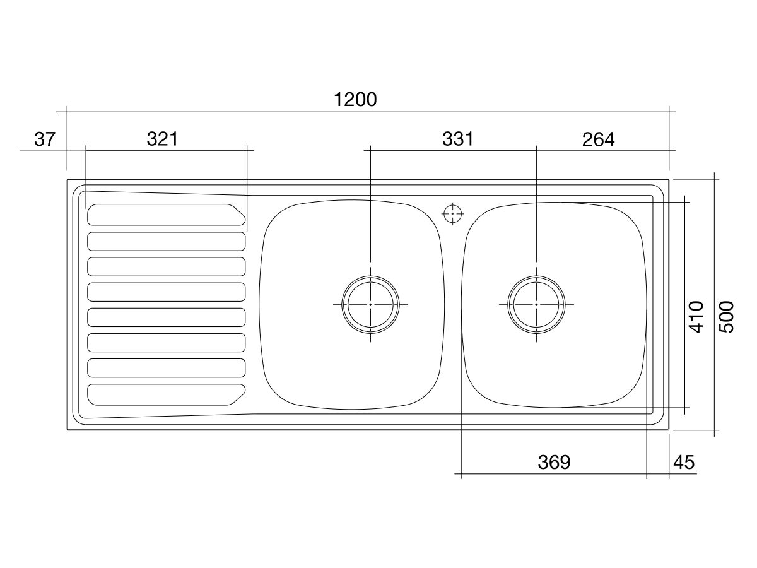
Presentation of Quote 444511196
Base MkII Double Bowl Sink 1th Rhb S/S
Product Code:
2000157
Warranty:
Warranty - Domestic Use: 7 Years Warranty Information: For full warranty terms and conditions please refer to the Base Warranty document Warranty - Commercial Use: 12 Months Spare Parts and Labour: 12 Months
Valid Until 6th January 2025
All images are for illustration purposes only - not for construction. Colours & Sizes can vary & may be subject to change

Slide 6
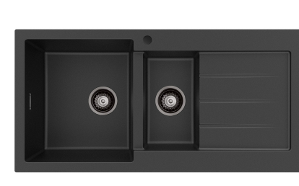
Presentation of Quote 444511196
GRANITE SINK
Product Code:
101
Valid Until 6th January 2025
All images are for illustration purposes only - not for construction. Colours & Sizes can vary & may be subject to change

Slide 7
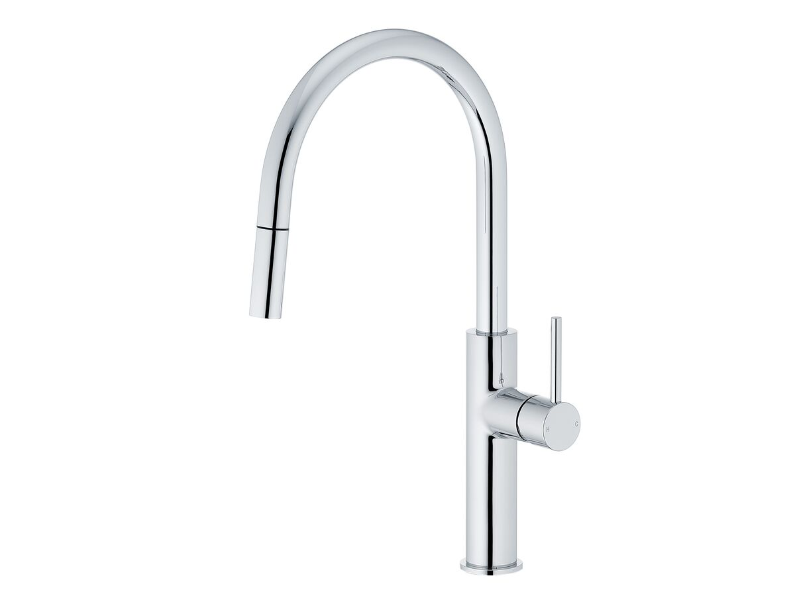
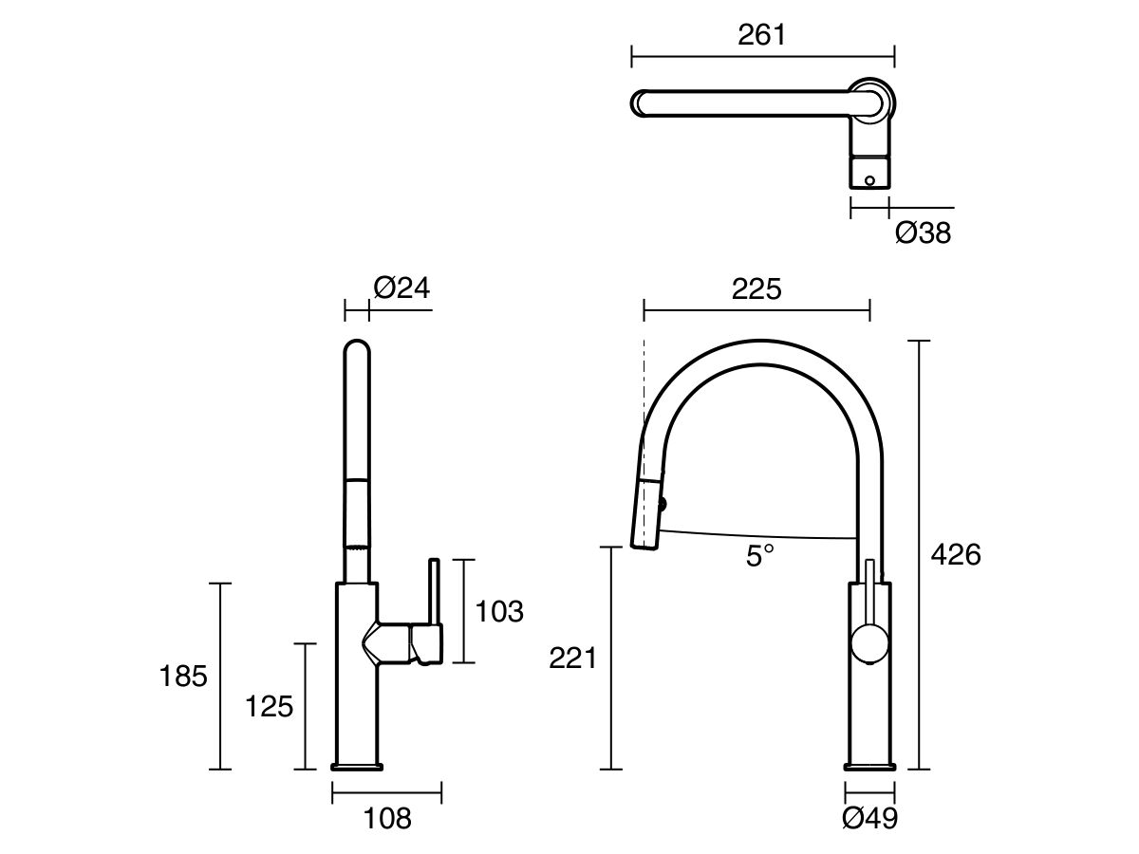
Presentation of Quote 444511196
Mizu Drift GN PO Sink MIX CV 2F CP 5*lf
Product Code:
2265801
Valid Until 6th January 2025
All images are for illustration purposes only - not for construction. Colours & Sizes can vary & may be subject to change

Slide 8
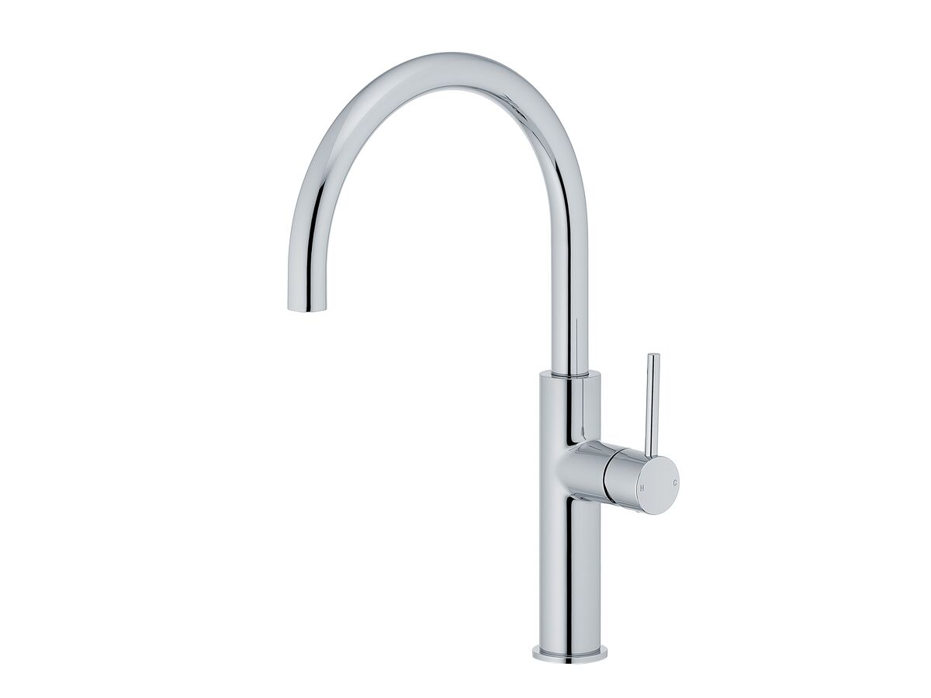
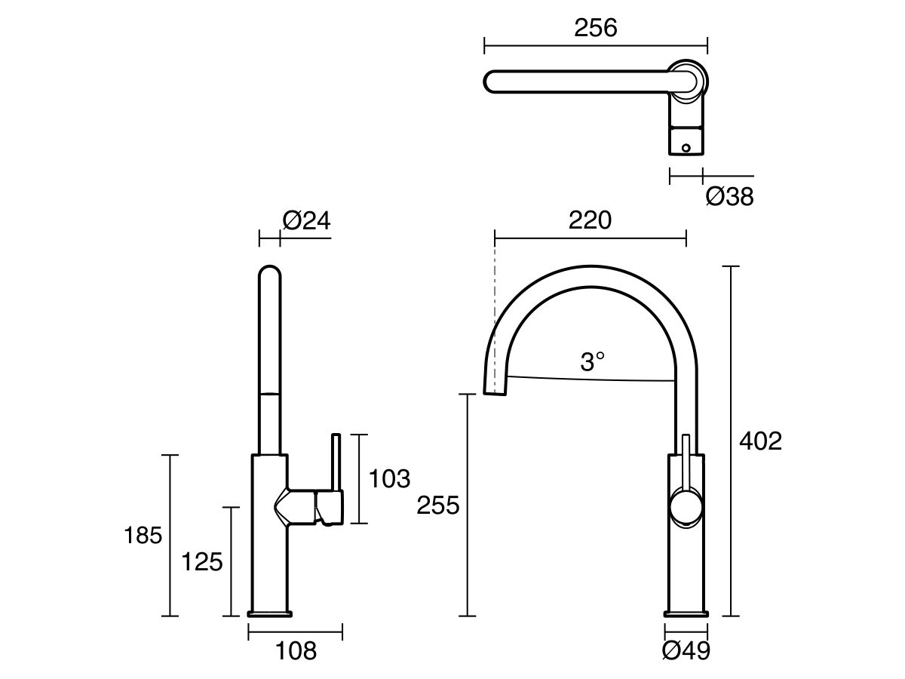
Presentation of Quote 444511196
Mizu Drift G/N Sink Mixer Crv CP (5*) LF
Product Code:
2265797
Valid Until 6th January 2025
All images are for illustration purposes only - not for construction. Colours & Sizes can vary & may be subject to change

Slide 9
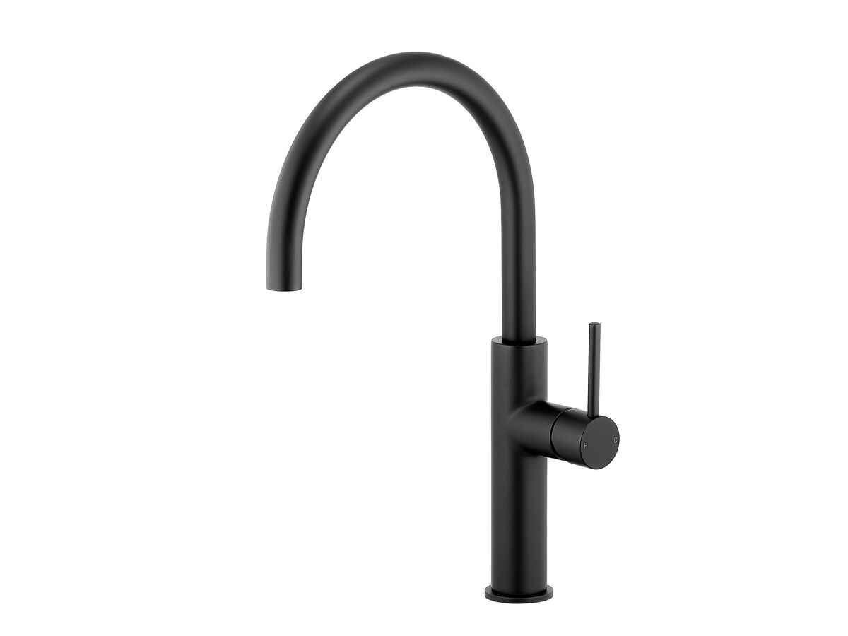
Presentation of Quote 444511196
Mizu Drift G/N Sink Mixer Crv MB (5*) LF
Product Code:
2265798
Valid Until 6th January 2025
All images are for illustration purposes only - not for construction. Colours & Sizes can vary & may be subject to change

Slide 10
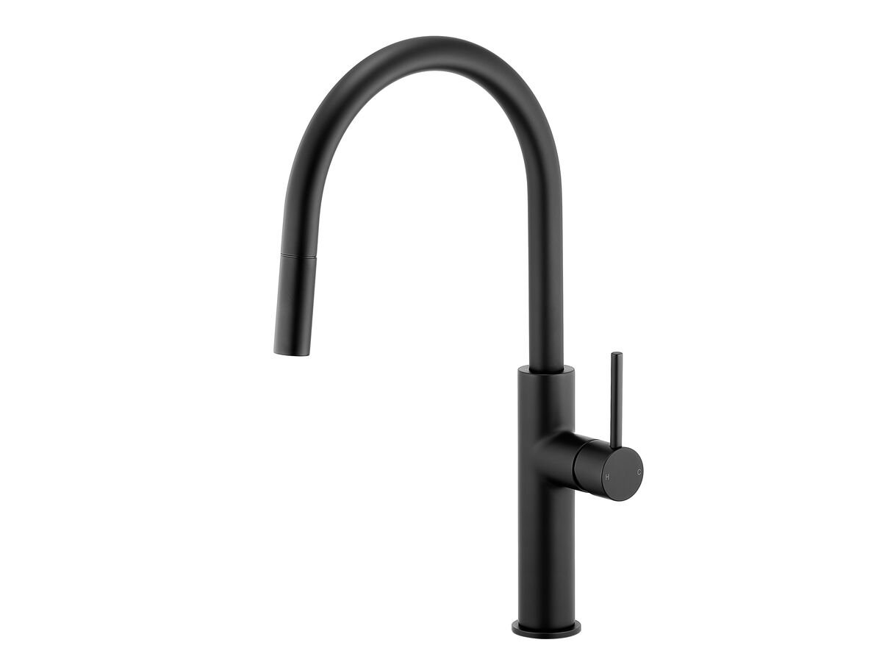
Presentation of Quote 444511196
Mizu Drift GN PO Sink MIX CV 2F MB 5*lf
Product Code:
2265802
Valid Until 6th January 2025
All images are for illustration purposes only - not for construction. Colours & Sizes can vary & may be subject to change

Slide 11
--BATHROOMS LAUNDRY & TOILET---

Slide 12
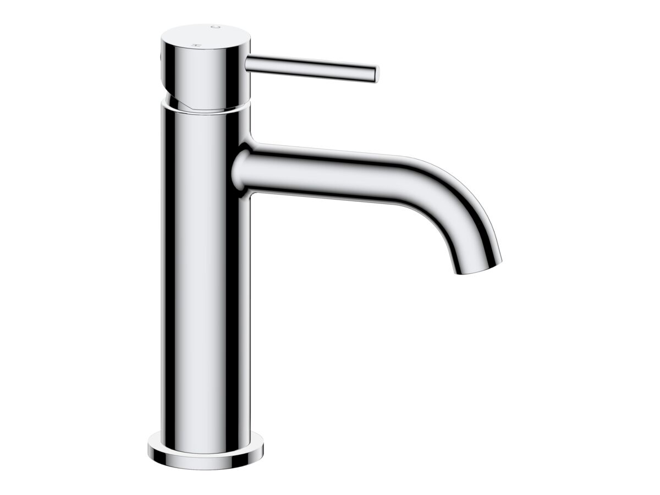
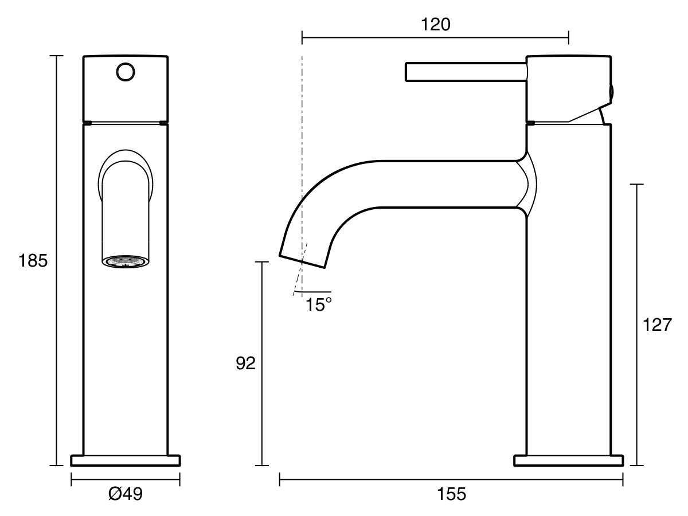
Presentation of Quote 444511196
Mizu Drift Basin Mixer Crv CP (6*) LF
Product Code:
2267198
Valid Until 6th January 2025
All images are for illustration purposes only - not for construction. Colours & Sizes can vary & may be subject to change

Slide 13
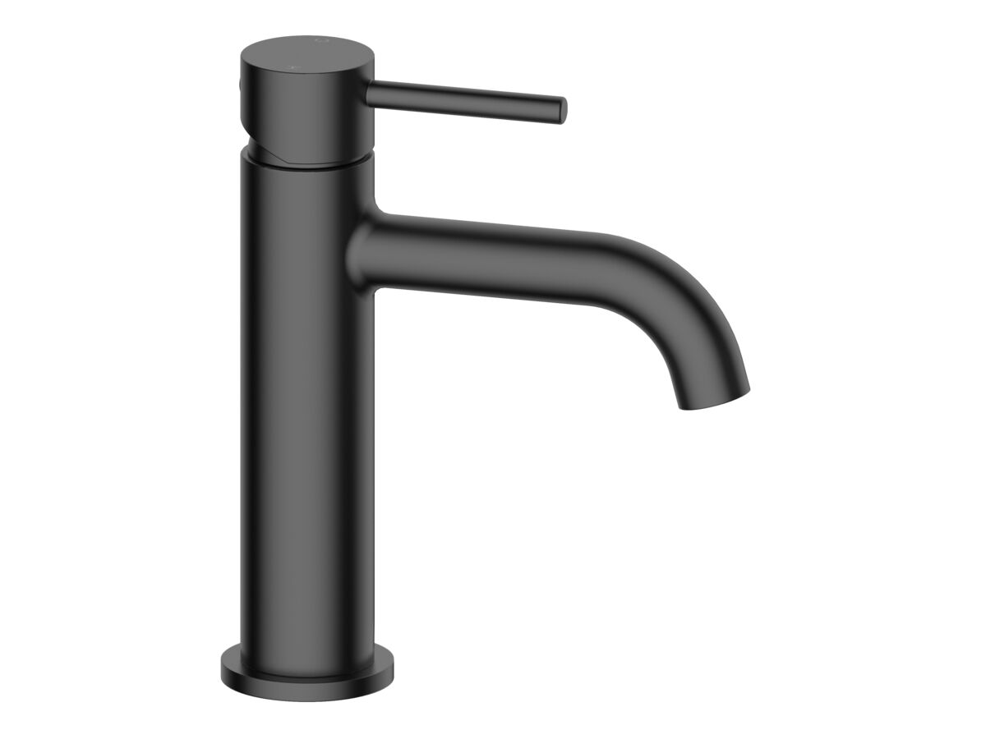
Presentation of Quote 444511196
Mizu Drift Basin Mixer Crv MB (6*) LF
Product Code:
2267220
Valid Until 6th January 2025
All images are for illustration purposes only - not for construction. Colours & Sizes can vary & may be subject to change

Slide 14
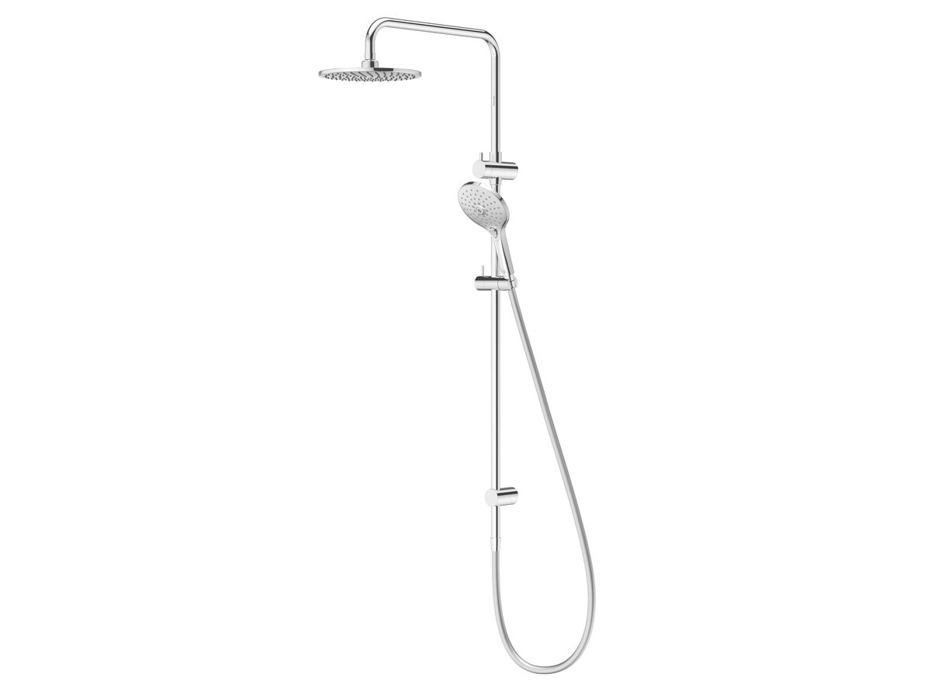
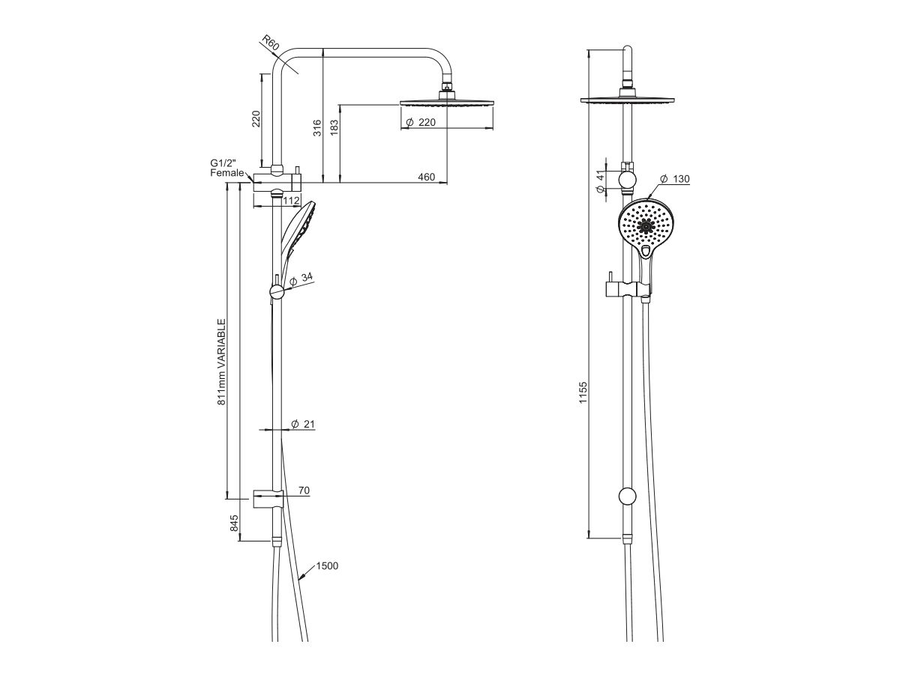
Presentation of Quote 444511196
Posh Domaine Twin Rail Shower CP (3*)
Product Code:
2213365
WELS:
Rating: 3 Star Rating Measure: 9 Litres Per Minute
Warranty:
Warranty - Domestic Use: 10 Years Warranty Information: For full warranty terms and conditions please refer to the Posh Warranty document. Warranty - Commercial Use: 12 Months Parts Replacement Only: 12 Months
Valid Until 6th January 2025
All images are for illustration purposes only - not for construction. Colours & Sizes can vary & may be subject to change

Slide 15
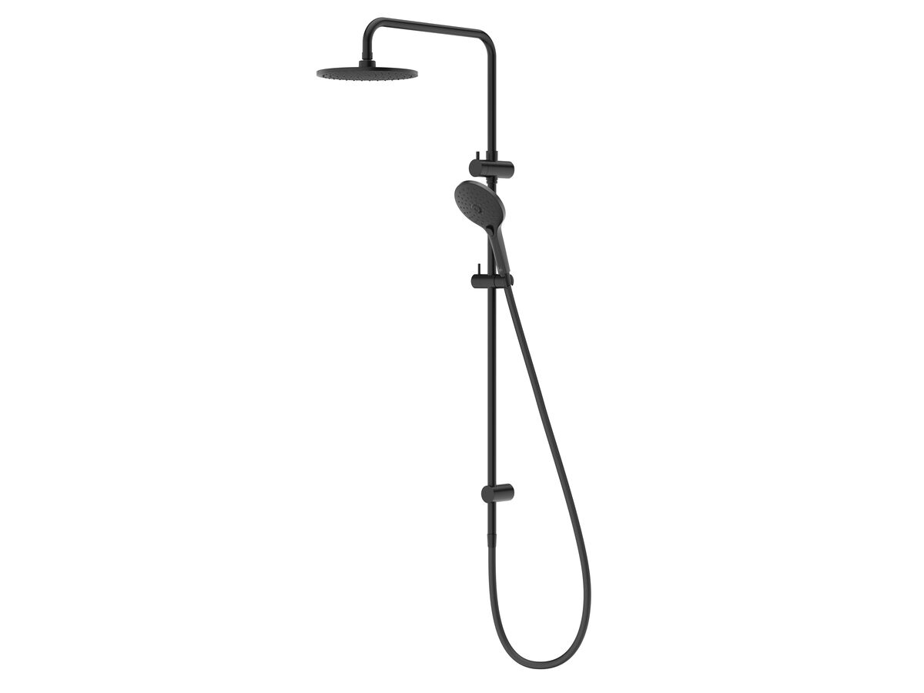
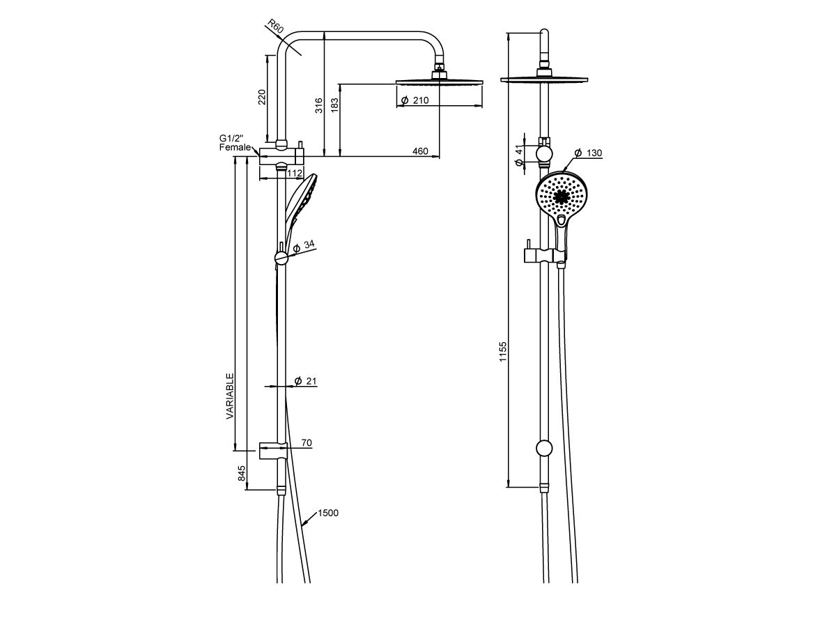
Presentation of Quote 444511196
Posh Domaine Twin Rail Shower MB (3*)
Product Code:
2213366
WELS:
Rating: 3 Star Rating Measure: 9 Litres Per Minute
Warranty:
Warranty - Domestic Use: 10 Years Warranty Information: For full warranty terms and conditions please refer to the Posh Warranty document. Warranty - Commercial Use: 12 Months Parts Replacement Only: 12 Months
Valid Until 6th January 2025
All images are for illustration purposes only - not for construction. Colours & Sizes can vary & may be subject to change

Slide 16
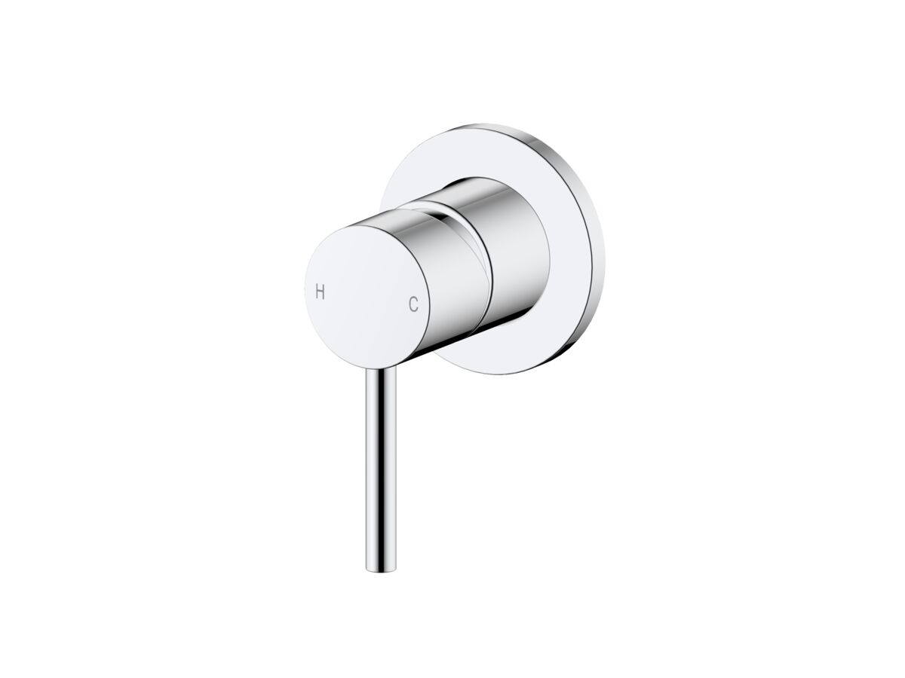
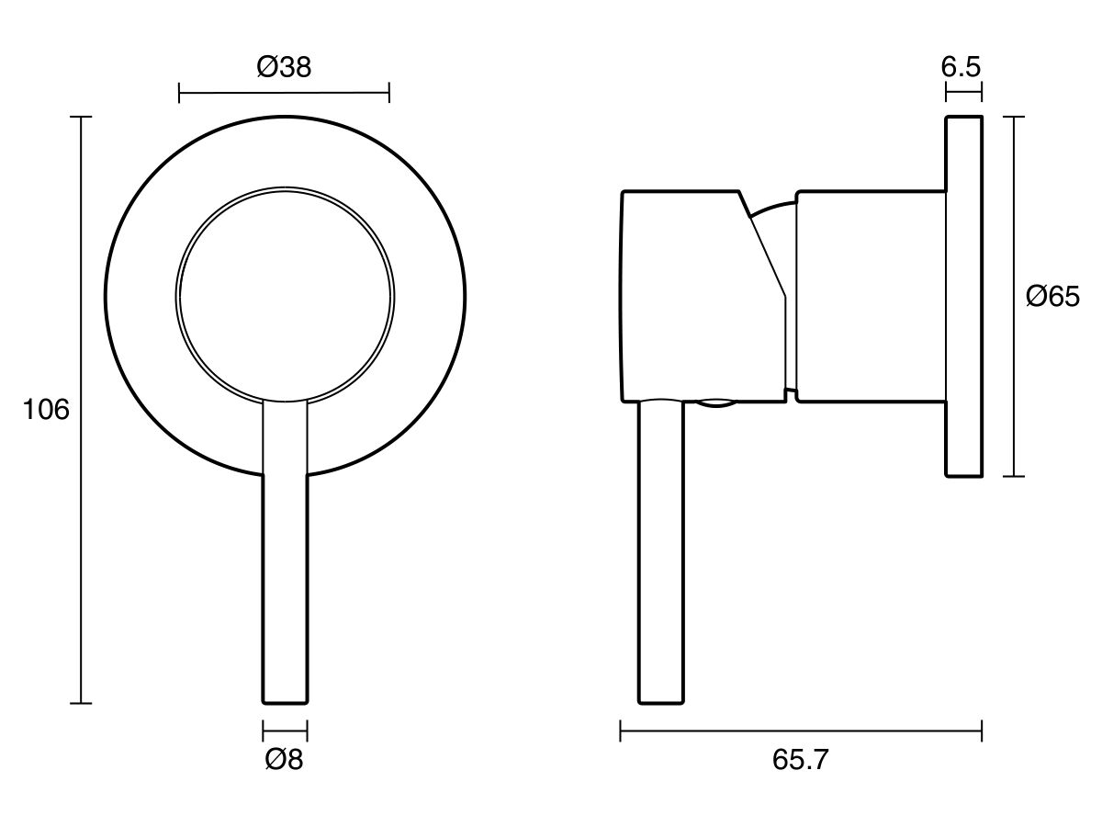
Presentation of Quote 444511196
Mizu Drift Shower Mixer Kit CP LF
Product Code:
2267361
Valid Until 6th January 2025
All images are for illustration purposes only - not for construction. Colours & Sizes can vary & may be subject to change

Slide 17
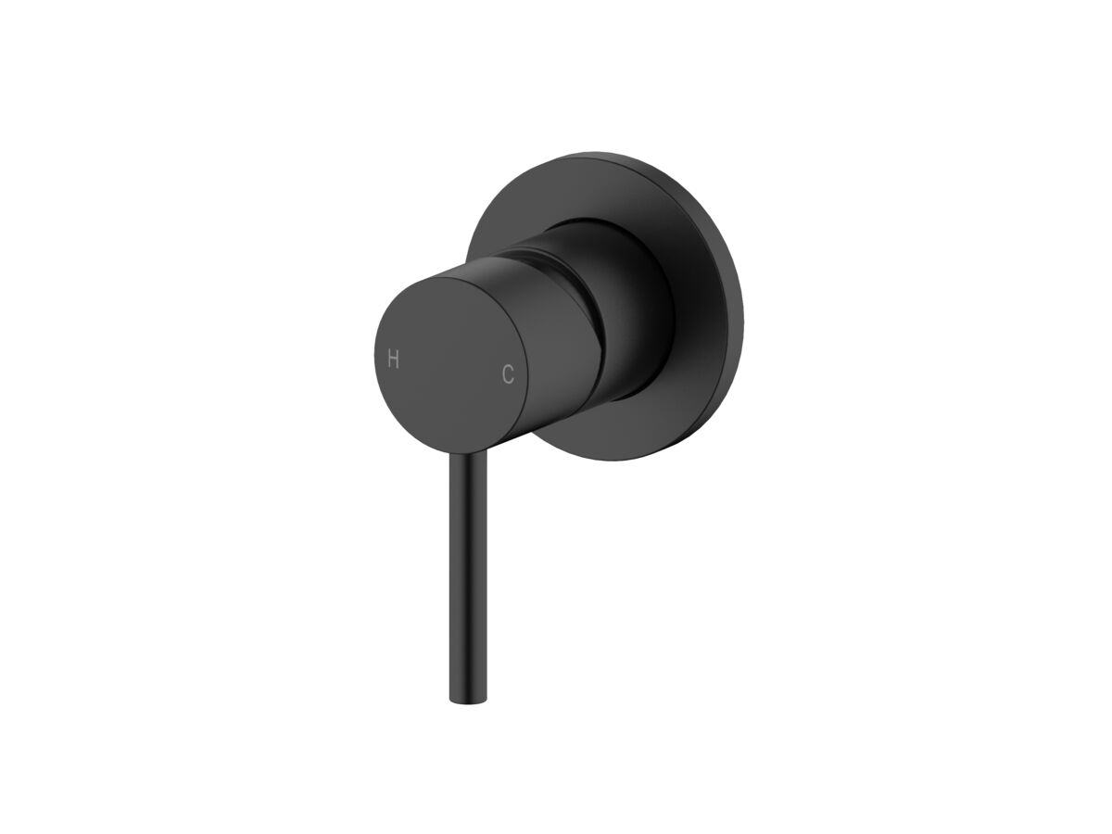
Presentation of Quote 444511196
Mizu Drift Shower Mixer Kit MB LF
Product Code:
2267368
Valid Until 6th January 2025
All images are for illustration purposes only - not for construction. Colours & Sizes can vary & may be subject to change

Slide 18
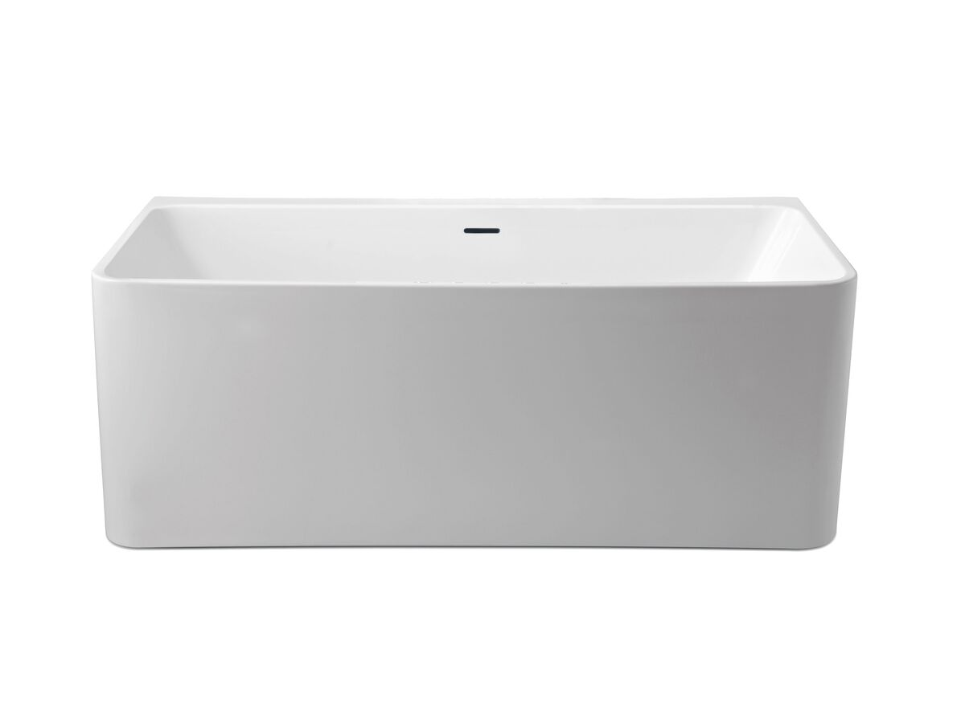
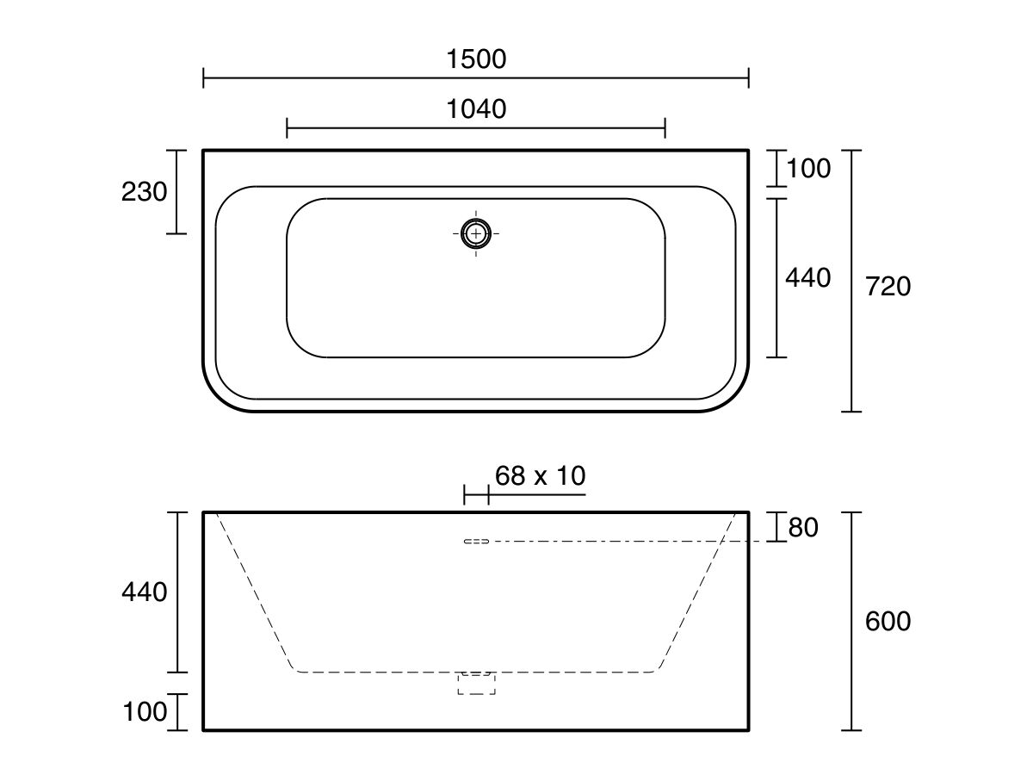
Presentation of Quote 444511196
Posh Domaine BTW F/S Bath 1500x720 WH OF
Product Code:
1703128
Warranty:
Warranty - Domestic Use: 10 Years Warranty Information: For full warranty terms and conditions please refer to the Posh Warranty document. Warranty - Commercial Use: 12 Months Spare Parts and Labour: 12 Months
Valid Until 6th January 2025
All images are for illustration purposes only - not for construction. Colours & Sizes can vary & may be subject to change

Slide 19
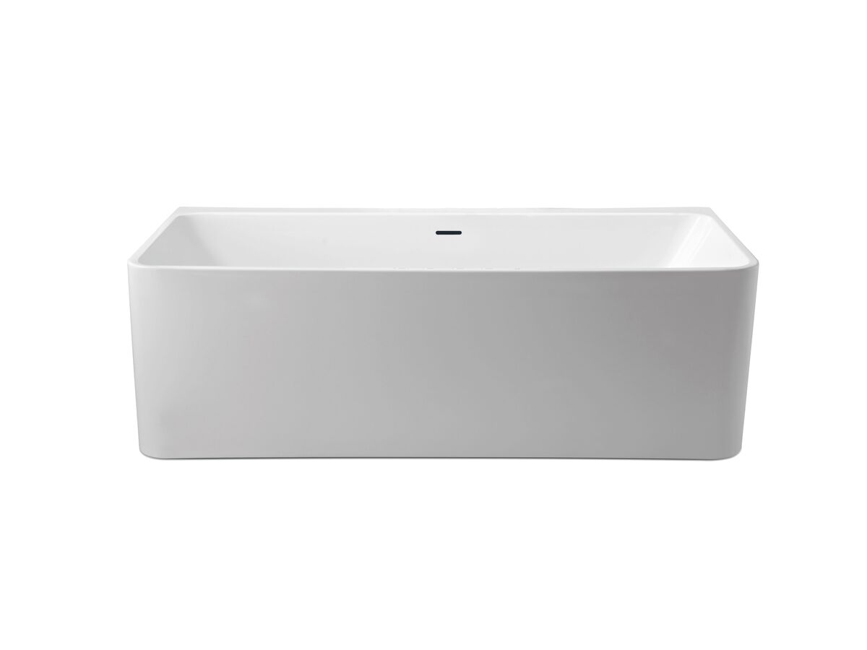
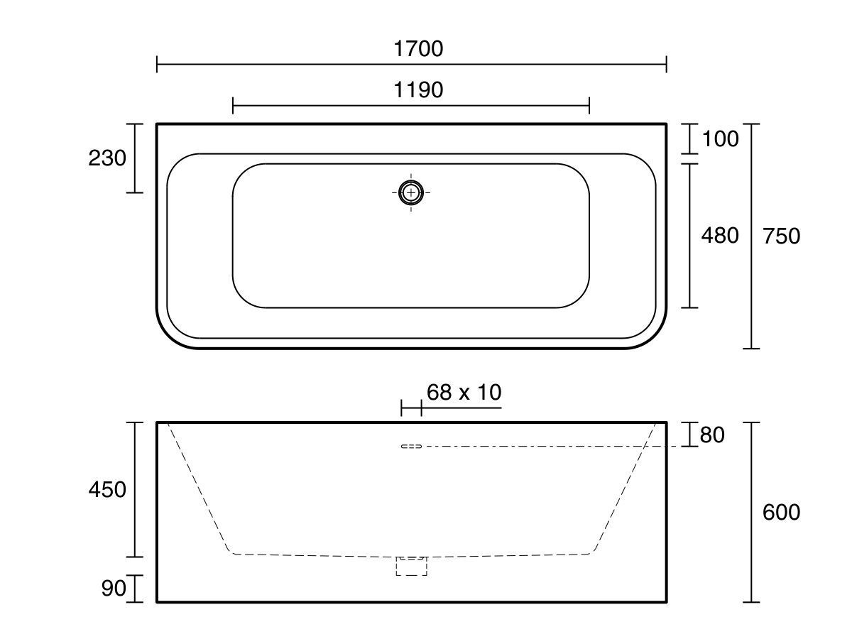
Presentation of Quote 444511196
Posh Domaine BTW F/S Bath 1700x750 WH OF
Product Code:
1703129
Warranty:
Warranty - Domestic Use: 10 Years Warranty Information: For full warranty terms and conditions please refer to the Posh Warranty document. Warranty - Commercial Use: 12 Months Spare Parts and Labour: 12 Months
Valid Until 6th January 2025
All images are for illustration purposes only - not for construction. Colours & Sizes can vary & may be subject to change

Slide 20
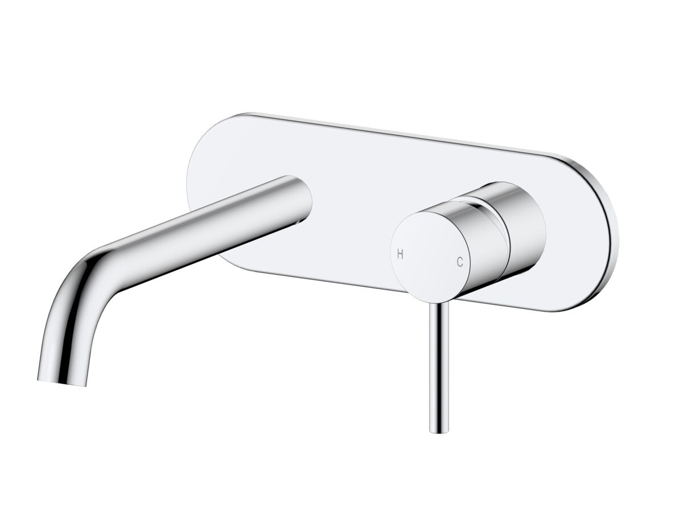
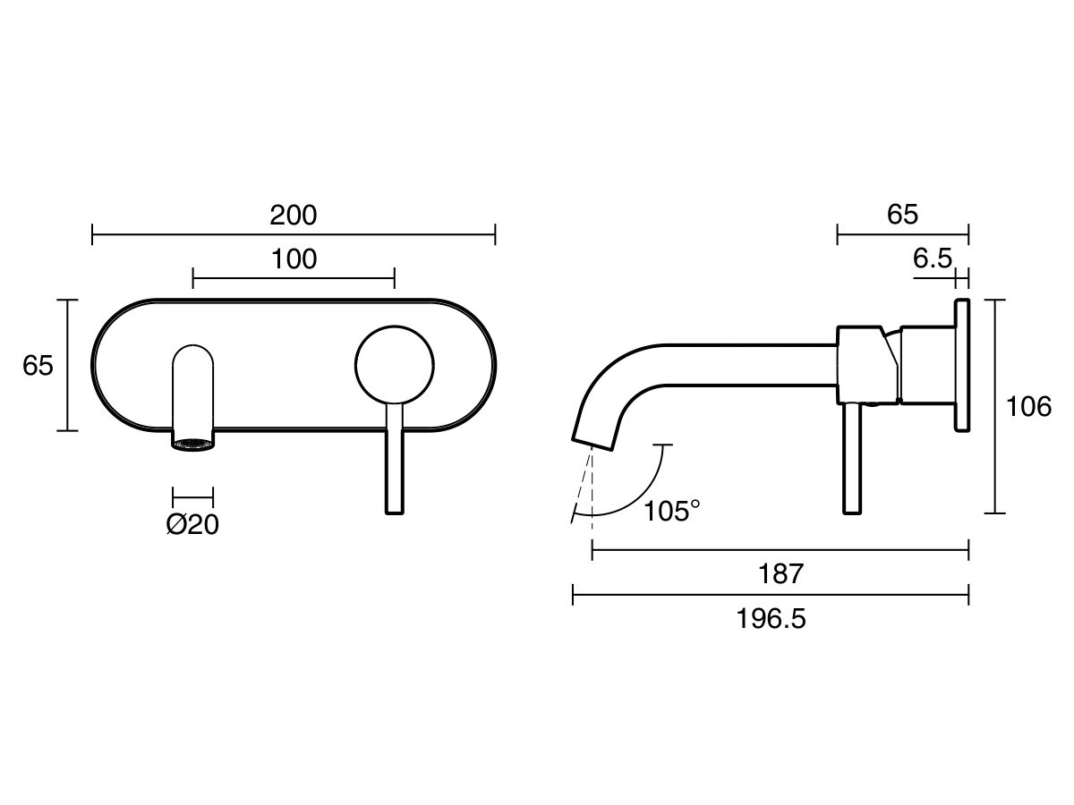
Presentation of Quote 444511196
Drift W/Bsn/Bth MIX Set Crv Kit CP (6*lf
Product Code:
2267365
Valid Until 6th January 2025
All images are for illustration purposes only - not for construction. Colours & Sizes can vary & may be subject to change

Slide 21
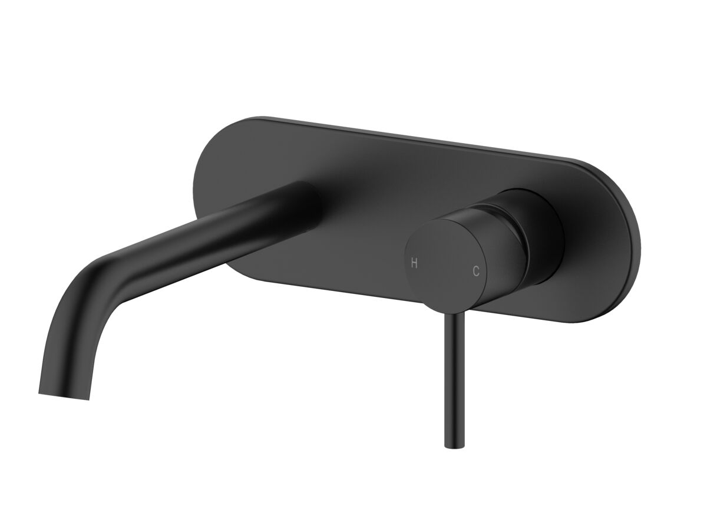
Presentation of Quote 444511196
Drift W/Bsn/Bth MIX Set Crv Kit MB (6*lf
Product Code:
2267372
Valid Until 6th January 2025
All images are for illustration purposes only - not for construction. Colours & Sizes can vary & may be subject to change

Slide 22
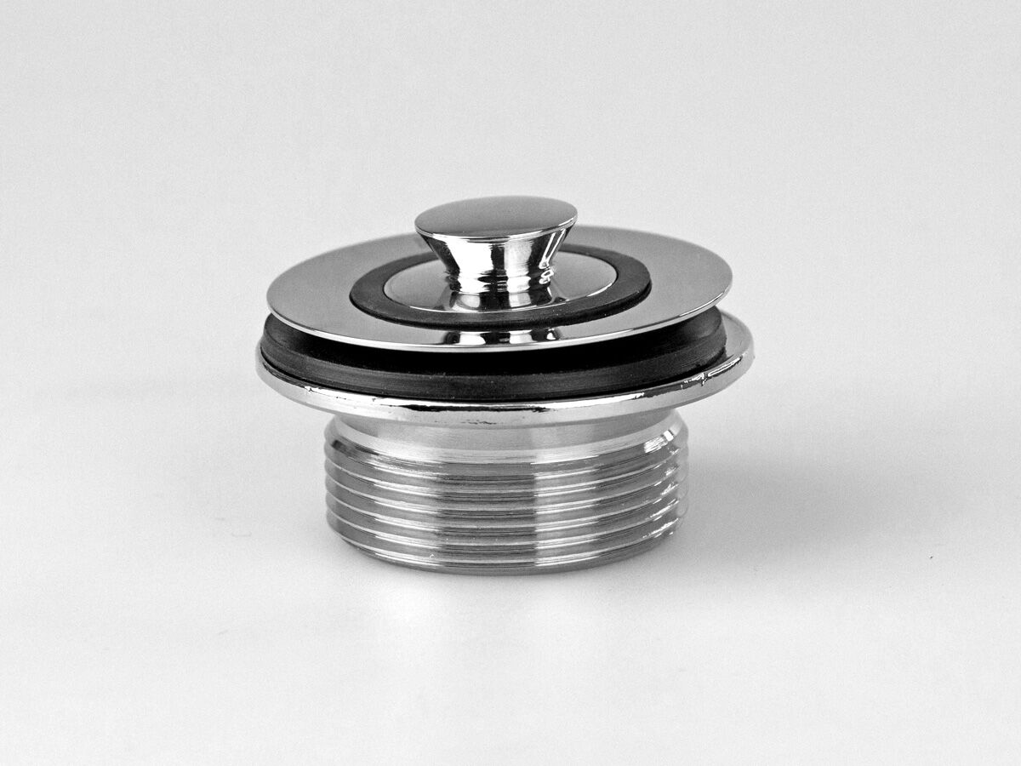
Presentation of Quote 444511196
Porch 32x40 Non O/F+O/F Special Waste CP
Product Code:
1852363
Warranty:
Warranty - Domestic Use: 12 Months Replacement Warranty: 12 Months
Valid Until 6th January 2025
All images are for illustration purposes only - not for construction. Colours & Sizes can vary & may be subject to change

Slide 23
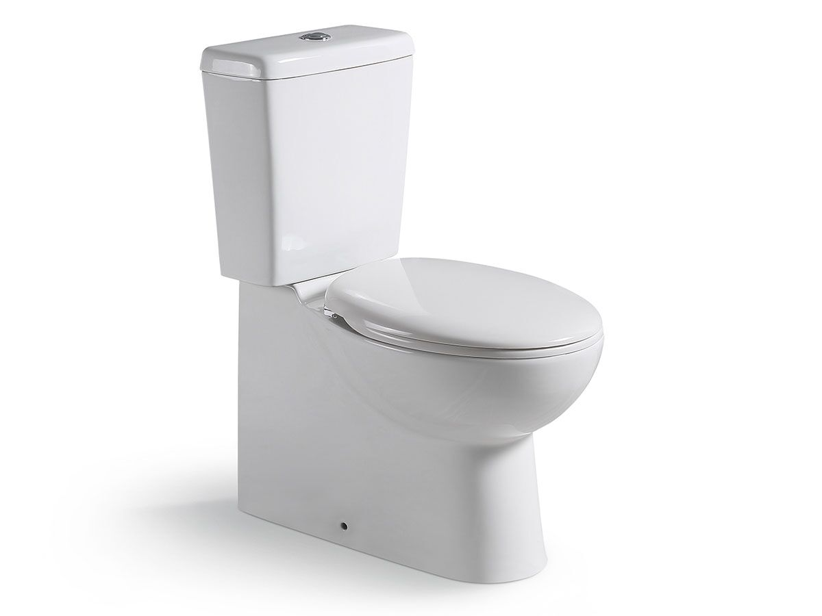
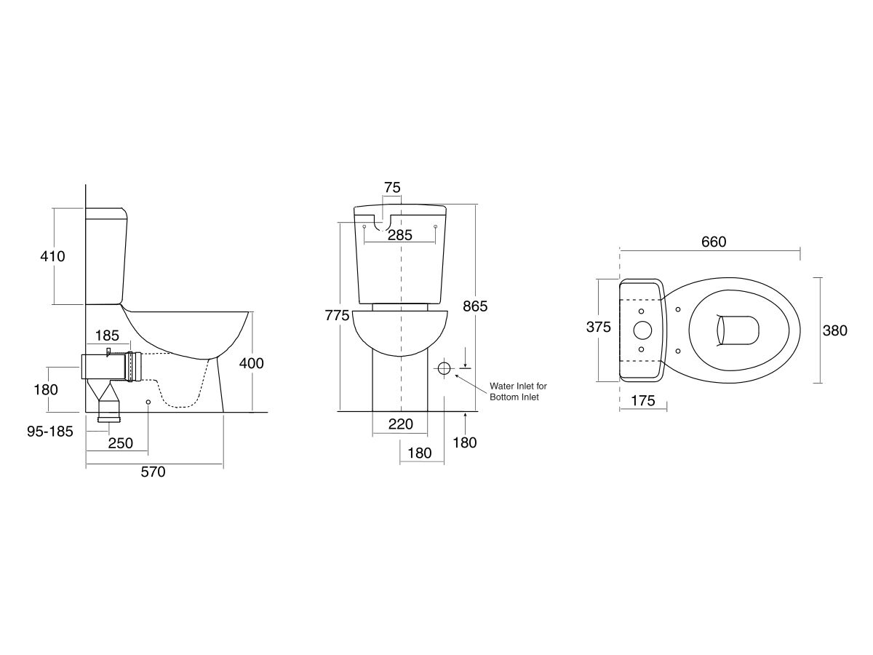
Presentation of Quote 444511196
Posh Solus Sqr Ccbtw Bk/In Scqrs WH (4*)
Product Code:
9505481
WELS:
Rating: 4 Star Rating Measure: 3.5 Average Ltrs Per Flush Measure: 4.5 Litres Per Full Flush
Warranty:
Warranty - Domestic Use: 10 Years Warranty Information: For full warranty terms and conditions please refer to the Posh Warranty document. Warranty - Commercial Use: 12 Months Spare Parts and Labour: 12 Months
Valid Until 6th January 2025
All images are for illustration purposes only - not for construction. Colours & Sizes can vary & may be subject to change

Slide 24
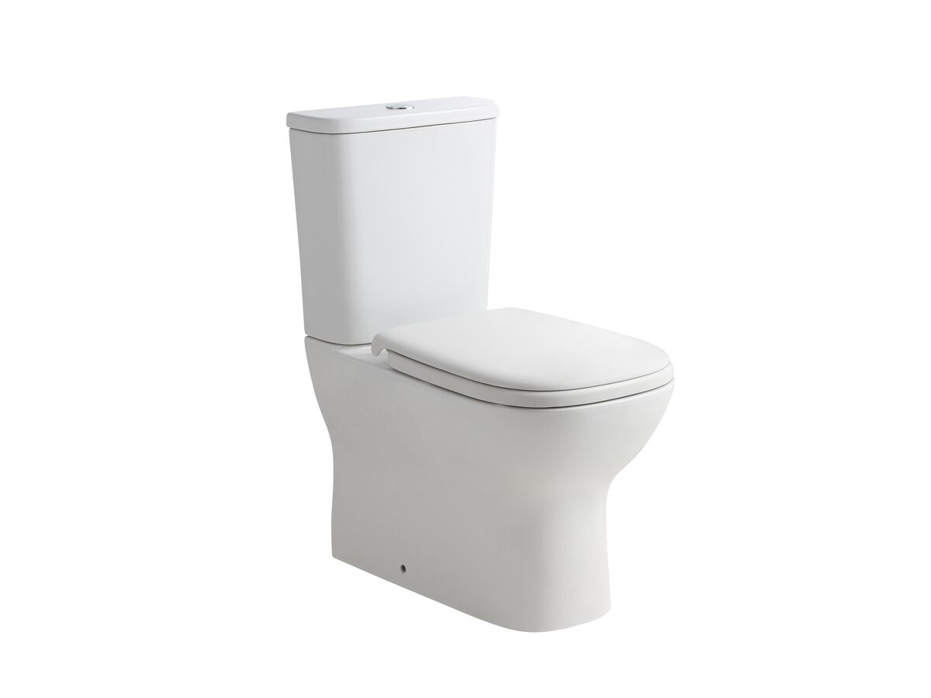
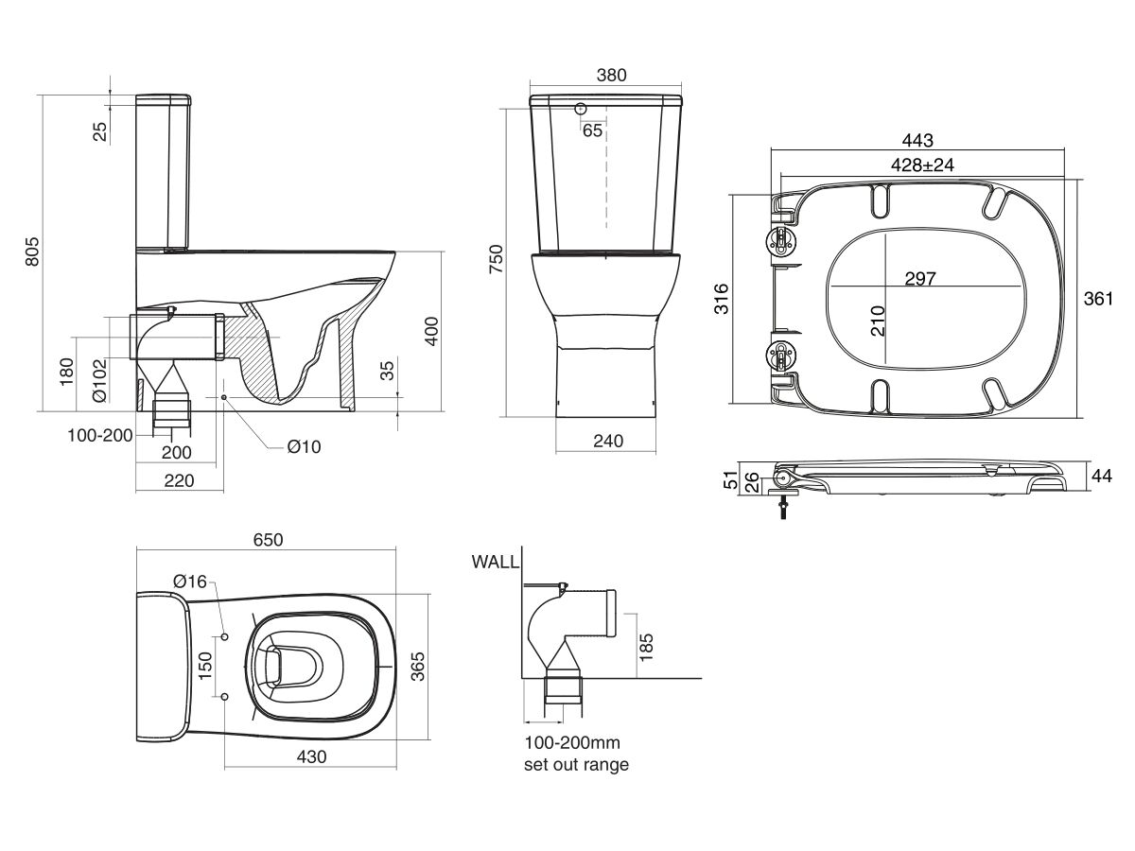
Presentation of Quote 444511196
Posh Domaine Ccbtw RL TS Bk/In Scqrs 4*
Product Code:
9509218
WELS:
Rating: 4 Star Rating Measure: 3.5 Average Ltrs Per Flush Measure: 4.5 Litres Per Full Flush
Warranty:
Warranty - Domestic Use: 10 Years Warranty Information: For full warranty terms and conditions please refer to the Posh Warranty document. Warranty - Commercial Use: 12 Months Spare Parts and Labour: 12 Months
Valid Until 6th January 2025
All images are for illustration purposes only - not for construction. Colours & Sizes can vary & may be subject to change

Slide 25
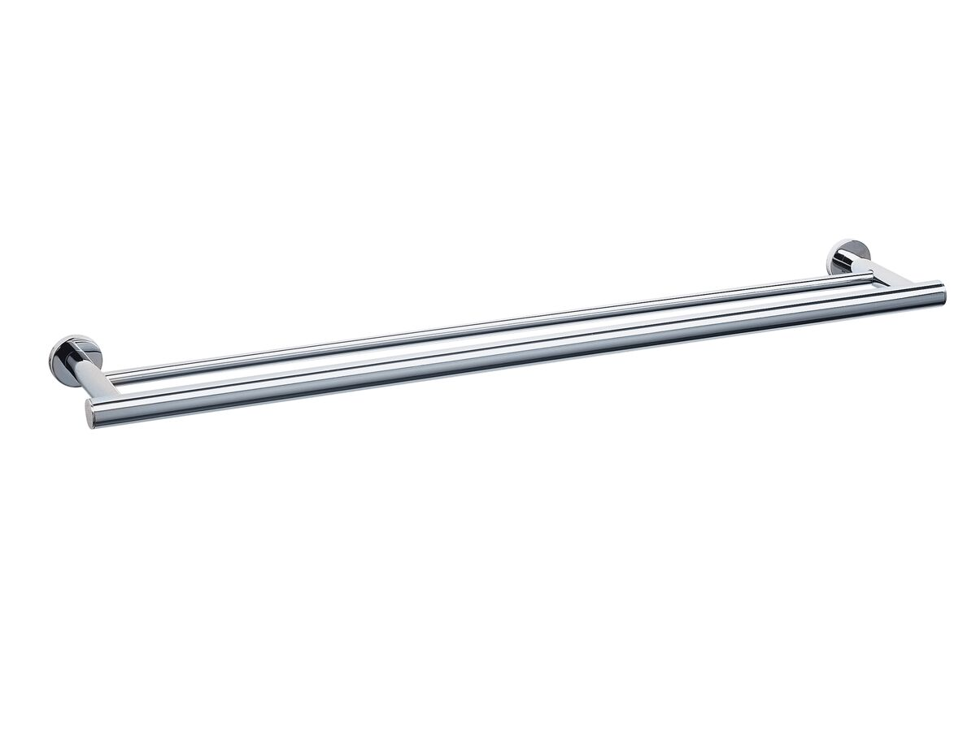
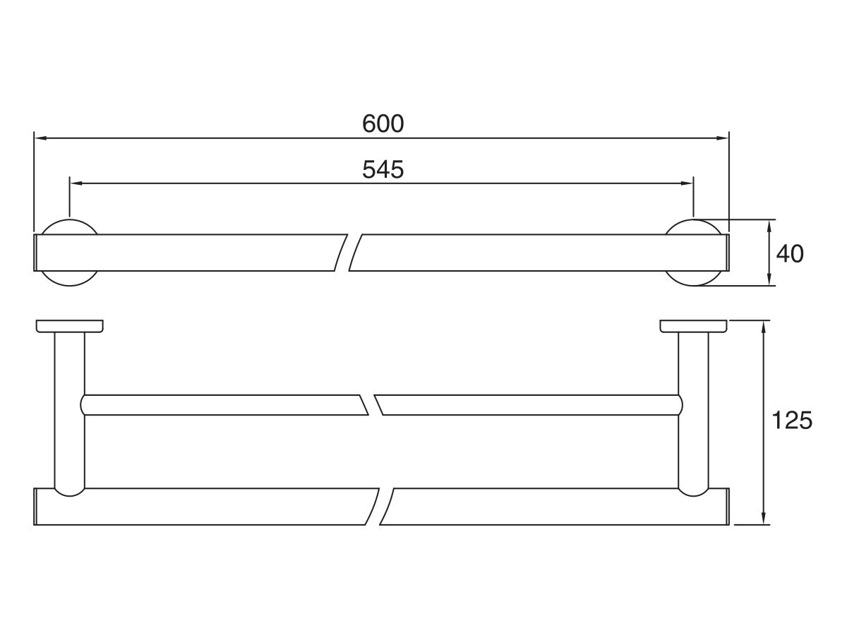
Presentation of Quote 444511196
Mizu Drift Double Towel Rail 600mm CP
Product Code:
2202018
Warranty:
Warranty Information: For full warranty terms and conditions please refer to the Mizu Warranty document Replacement Only - Domestic Use: 10 Years Replacement Only - Commercial Use: 12 Months
Valid Until 6th January 2025
All images are for illustration purposes only - not for construction. Colours & Sizes can vary & may be subject to change

Slide 26
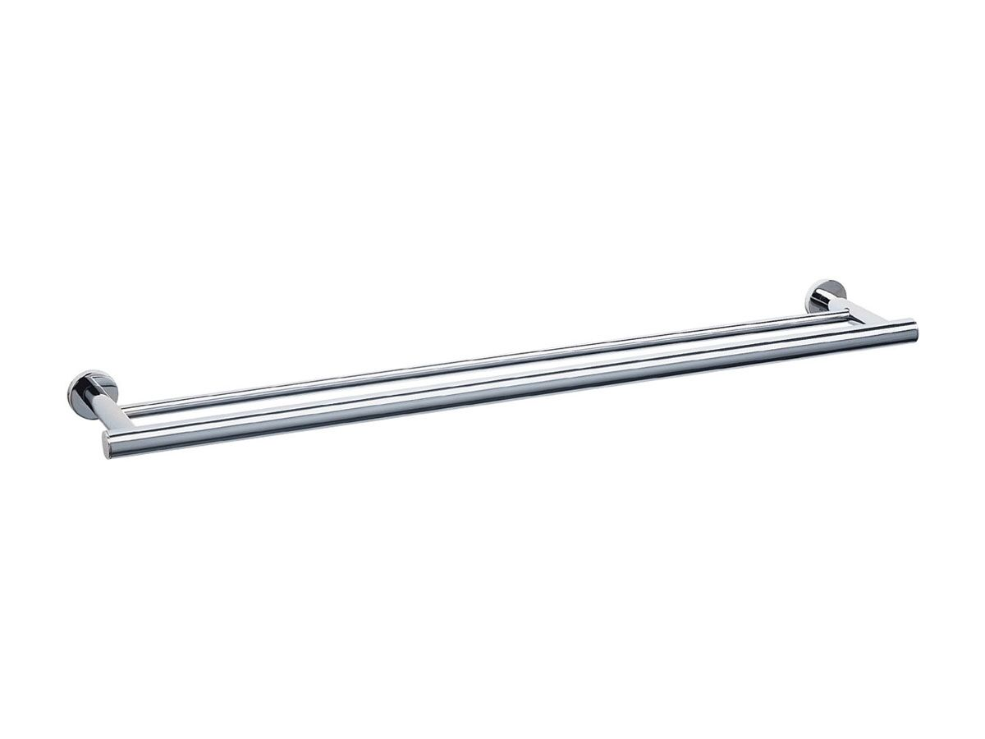
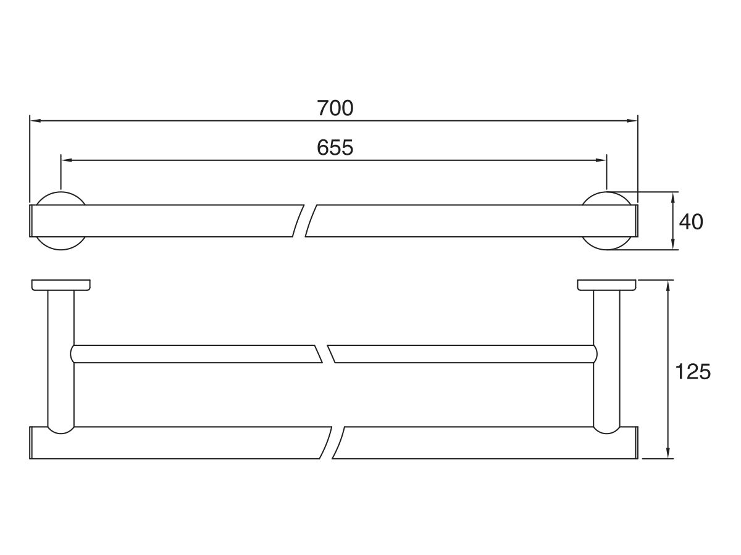
Presentation of Quote 444511196
Mizu Drift Double Towel Rail 700mm CP
Product Code:
2202019
Warranty:
Warranty Information: For full warranty terms and conditions please refer to the Mizu Warranty document Parts Replacement Only: 12 Months Replacement Only - Domestic Use: 10 Years Replacement Only - Commercial Use: 12 Months
Valid Until 6th January 2025
All images are for illustration purposes only - not for construction. Colours & Sizes can vary & may be subject to change

Slide 27
Presentation of Quote 444511196
Mizu Drift Double Towel Rail 900mm CP
Product Code:
9502116
Warranty:
Warranty Information: For full warranty terms and conditions please refer to the Mizu Warranty document Replacement Only - Domestic Use: 10 Years Replacement Only - Commercial Use: 12 Months
Valid Until 6th January 2025
All images are for illustration purposes only - not for construction. Colours & Sizes can vary & may be subject to change

Slide 28
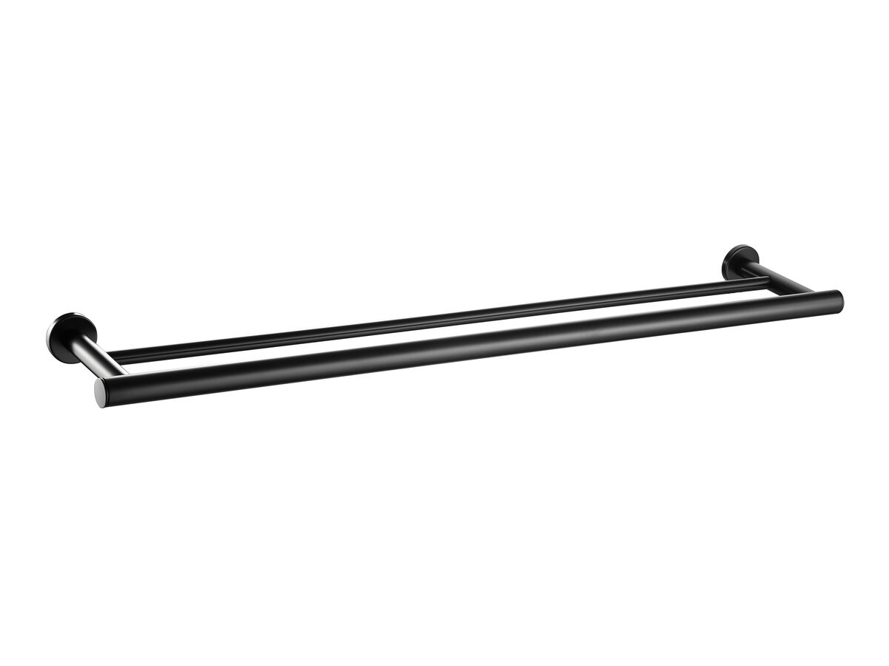
Presentation of Quote 444511196
Mizu Drift Double Towel Rail 600mm MB
Product Code:
9506774
Warranty:
Warranty Information: For full warranty terms and conditions please refer to the Mizu Warranty document Replacement Only - Domestic Use: 10 Years Replacement Only - Commercial Use: 12 Months
Valid Until 6th January 2025
All images are for illustration purposes only - not for construction. Colours & Sizes can vary & may be subject to change

Slide 29
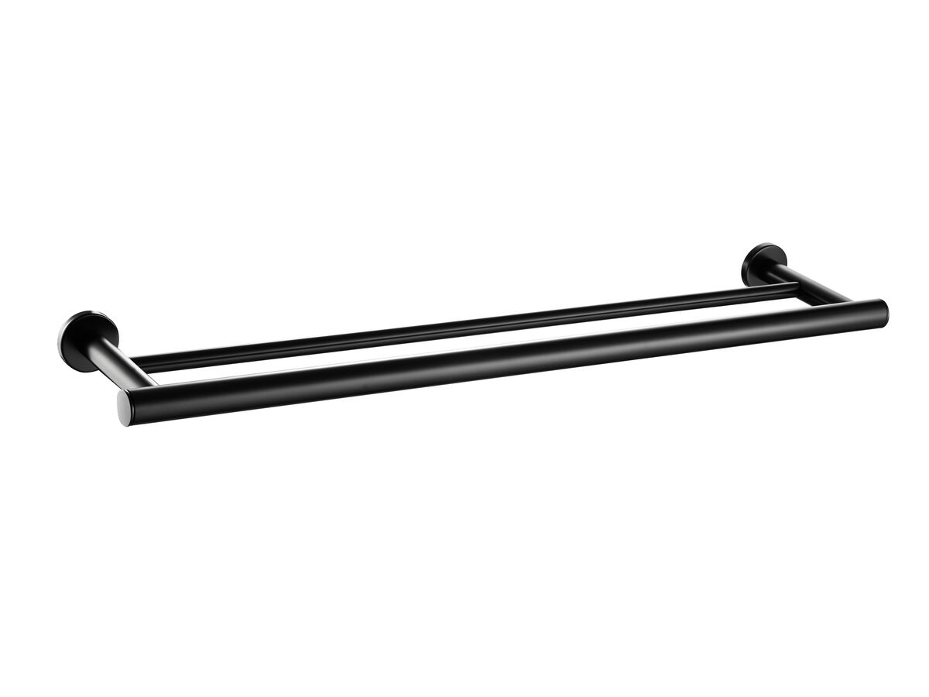
Presentation of Quote 444511196
Mizu Drift Double Towel Rail 700mm MB
Product Code:
9506776
Warranty:
Warranty Information: For full warranty terms and conditions please refer to the Mizu Warranty document Parts Replacement Only: 12 Months Replacement Only - Domestic Use: 10 Years Replacement Only - Commercial Use: 12 Months
Valid Until 6th January 2025
All images are for illustration purposes only - not for construction. Colours & Sizes can vary & may be subject to change

Slide 30
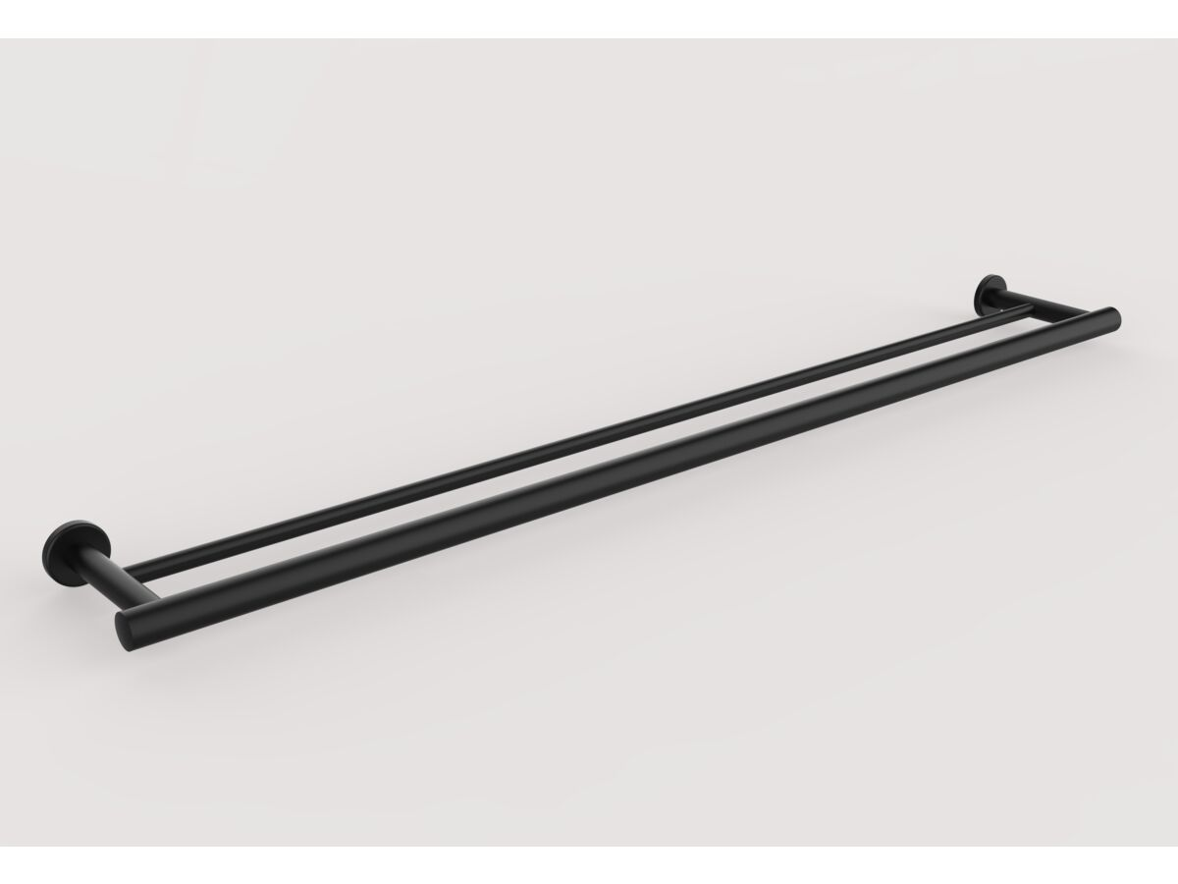
Presentation of Quote 444511196
Mizu Drift Double Towel Rail 900mm MB
Product Code:
9512554
Warranty:
Warranty Information: For full warranty terms and conditions please refer to the Mizu Warranty document Parts Replacement Only: 12 Months Replacement Only - Domestic Use: 10 Years Replacement Only - Commercial Use: 12 Months
Valid Until 6th January 2025
All images are for illustration purposes only - not for construction. Colours & Sizes can vary & may be subject to change

Slide 31
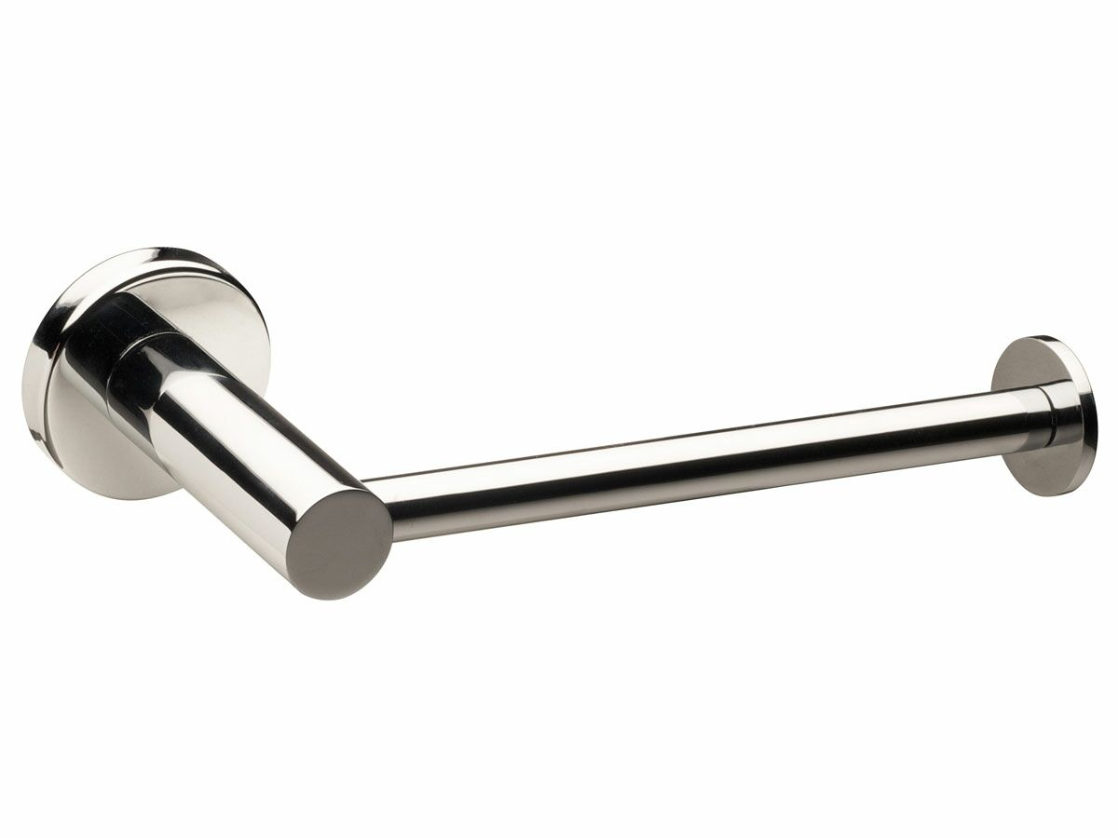
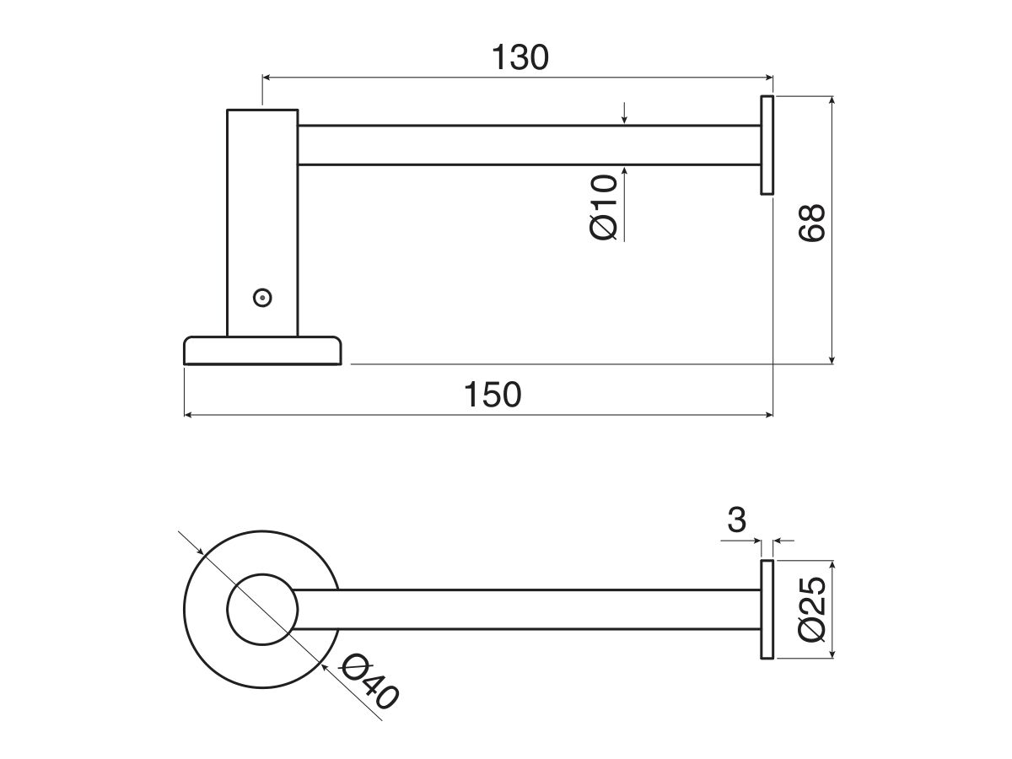
Presentation of Quote 444511196
Mizu Drift Straight T/Roll Holder CP
Product Code:
9504247
Warranty:
Warranty Information: For full warranty terms and conditions please refer to the Mizu Warranty document Parts Replacement Only: 12 Months Replacement Only - Domestic Use: 10 Years Replacement Only - Commercial Use: 12 Months
Valid Until 6th January 2025
All images are for illustration purposes only - not for construction. Colours & Sizes can vary & may be subject to change

Slide 32
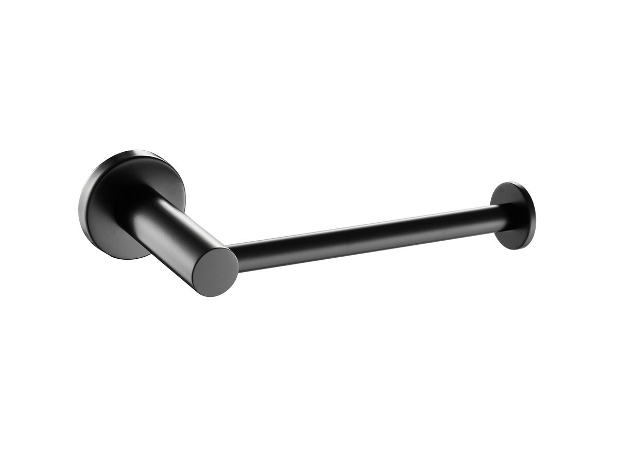
Presentation of Quote 444511196
Mizu Drift Straight T/Roll Holder MB
Product Code:
9506770
Warranty:
Warranty Information: For full warranty terms and conditions please refer to the Mizu Warranty document Parts Replacement Only: 12 Months Replacement Only - Domestic Use: 10 Years Replacement Only - Commercial Use: 12 Months
Valid Until 6th January 2025
All images are for illustration purposes only - not for construction. Colours & Sizes can vary & may be subject to change

Slide 33
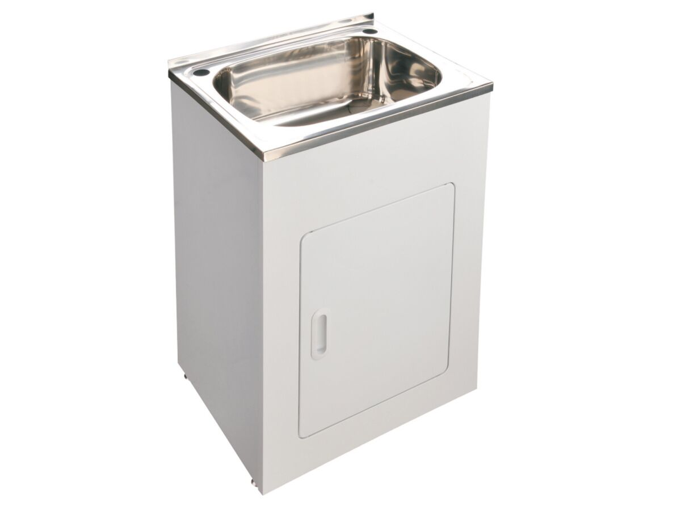
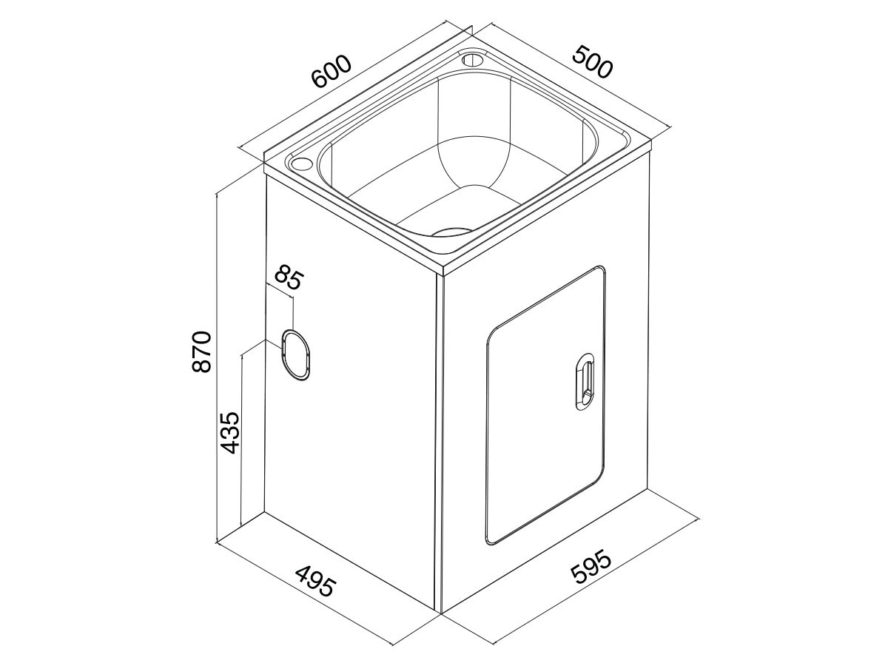
Presentation of Quote 444511196
Base Ldry Trough & Cab 45l 1th Ss/Wh
Product Code:
9504719
Warranty:
Warranty - Domestic Use: 7 Years Warranty Information: For full warranty terms and conditions please refer to the Base Warranty document Warranty - Commercial Use: 12 Months Spare Parts and Labour: 12 Months
Valid Until 6th January 2025
All images are for illustration purposes only - not for construction. Colours & Sizes can vary & may be subject to change

Slide 34
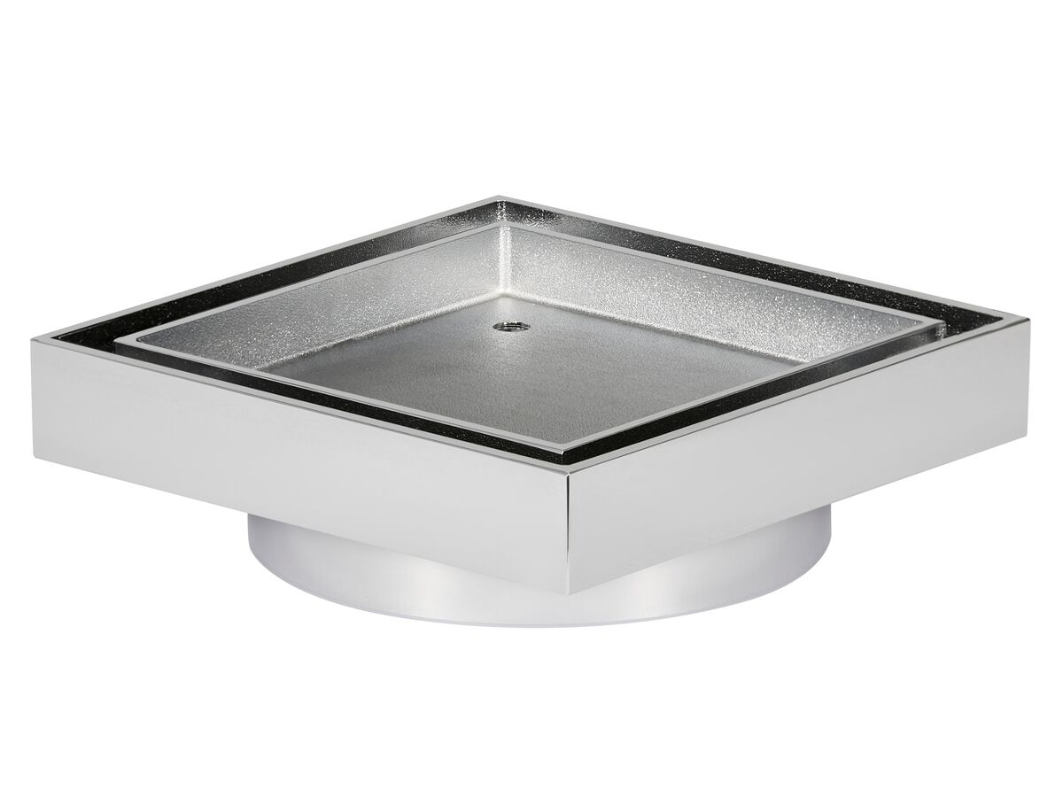
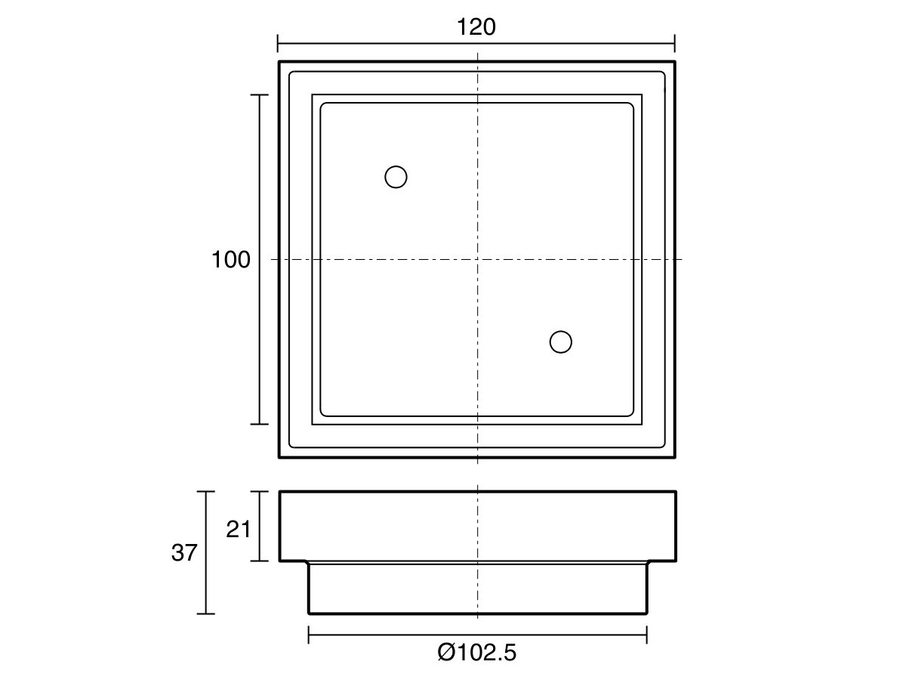
Presentation of Quote 444511196
Mizu Drift Tile Insert Waste 100mm CP
Product Code:
202209
Warranty:
Warranty Information: For full warranty terms and conditions please refer to the Mizu Warranty document Parts Replacement Only: 12 Months Replacement Only - Domestic Use: 2 Years
Valid Until 6th January 2025
All images are for illustration purposes only - not for construction. Colours & Sizes can vary & may be subject to change

Slide 35
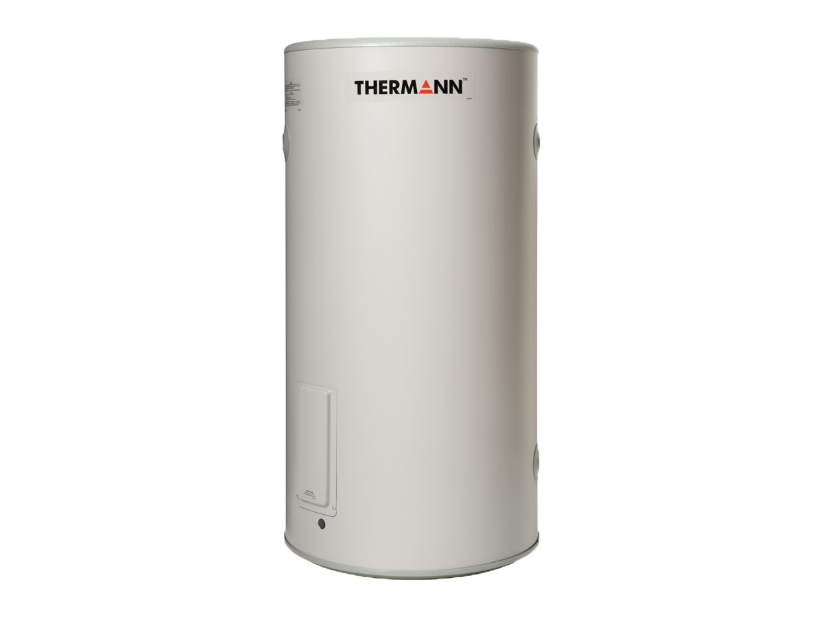
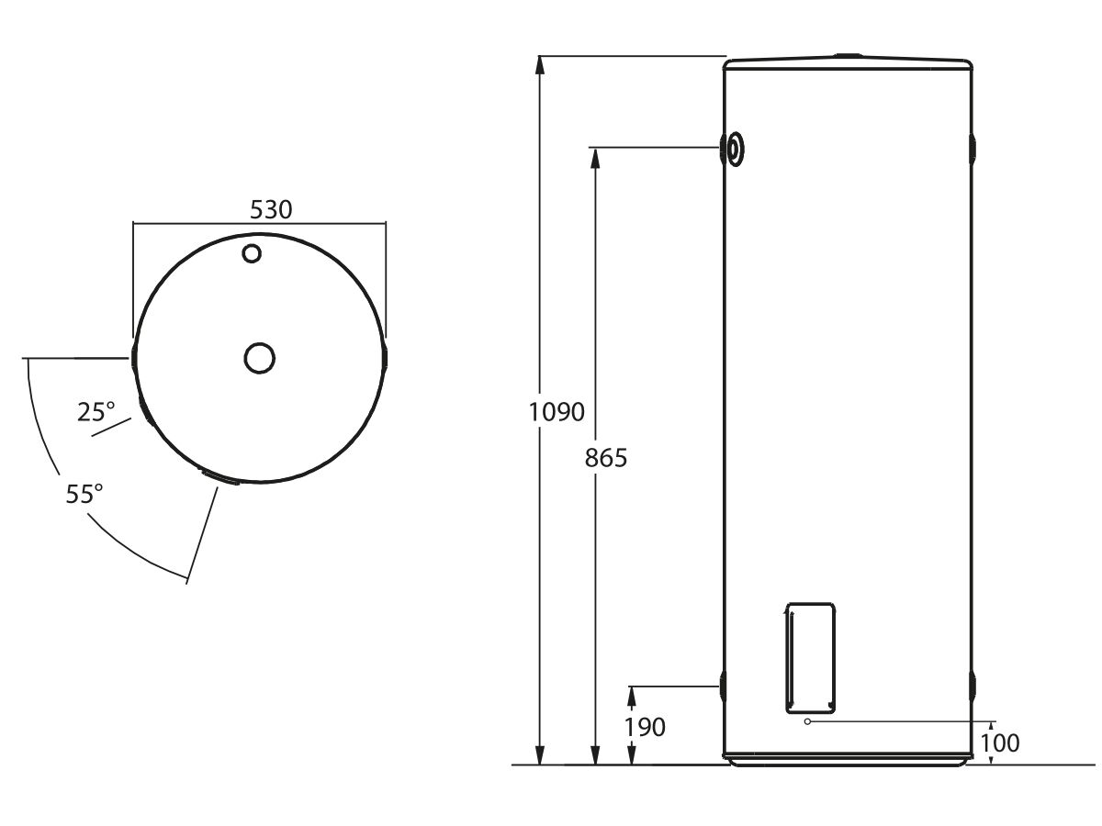
Presentation of Quote 444511196
Thermann Electric Hwu 10yr SE 125l 1.8kw
Product Code:
9507805
Warranty:
Warranty Information: Warranty terms and conditions are in the Owner's Manual. A Domestic Application is defined as a single family dwelling. A Commercial Application is anything other than an installation in a single family dwelling. Heat Exchanger Warranty - Domestic: 12 Months Spare Parts and Labour (Commercial): 12 Months Spare Parts and Labour (Domestic): 12 Months Parts & Labour- Domestic Ring Main on Timer: 12 Months Parts & Labour- Domestic Ring Main no Timer: 12 Months Tank Warranty - Commercial: 3 Years Tank Warranty - Domestic: 10 Years Tank Warranty - Domestic Ring Main: 10 Years
Valid Until 6th January 2025
All images are for illustration purposes only - not for construction. Colours & Sizes can vary & may be subject to change

Slide 36
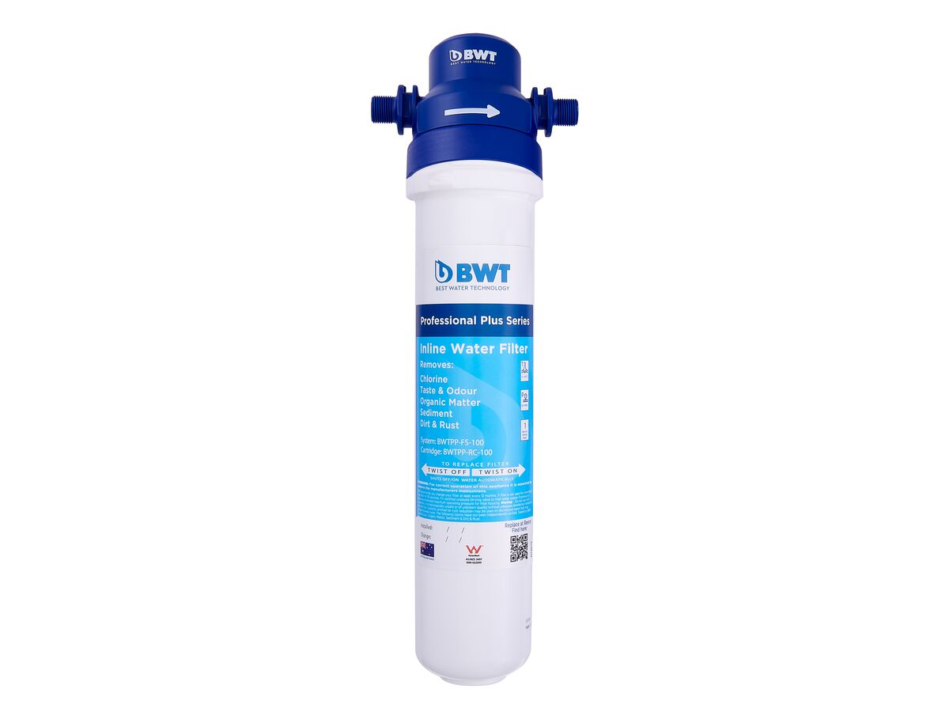
Presentation of Quote 444511196
Bwt Inline Water Filter Kit 1.0 Micron
Product Code:
1910993
Warranty:
Warranty Information: 7 Year System Warranty, 1 Year Head Warranty
Valid Until 6th January 2025
All images are for illustration purposes only - not for construction. Colours & Sizes can vary & may be subject to change

Slide 37
VANITIES

Slide 38
Presentation of Quote 444511196
600 WALL HUNG VANITY
Product Code:
101
Valid Until 6th January 2025
All images are for illustration purposes only - not for construction. Colours & Sizes can vary & may be subject to change

Slide 39
Presentation of Quote 444511196
600 FLOOR MOUNTED VANITY
Product Code:
101
Valid Until 6th January 2025
All images are for illustration purposes only - not for construction. Colours & Sizes can vary & may be subject to change

Slide 40
Presentation of Quote 444511196
750 WALL HUNG VANITY
Product Code:
101
Valid Until 6th January 2025
All images are for illustration purposes only - not for construction. Colours & Sizes can vary & may be subject to change

Slide 41
Presentation of Quote 444511196
750 FLOOR MOUNTED
Product Code:
101
Valid Until 6th January 2025
All images are for illustration purposes only - not for construction. Colours & Sizes can vary & may be subject to change

Slide 42
Presentation of Quote 444511196
900 WALL HUNG VANITY
Product Code:
101
Valid Until 6th January 2025
All images are for illustration purposes only - not for construction. Colours & Sizes can vary & may be subject to change

Slide 43
Presentation of Quote 444511196
900 FLOOR MOUNTED VANITY
Product Code:
101
Valid Until 6th January 2025
All images are for illustration purposes only - not for construction. Colours & Sizes can vary & may be subject to change

Slide 44
HOT WATER

Slide 45
Presentation of Quote 444511196
Thermann 20l G-Series C/Flow 50deg Lpg
Product Code:
1361329
Valid Until 6th January 2025
All images are for illustration purposes only - not for construction. Colours & Sizes can vary & may be subject to change

Slide 46
FILTER

Slide 47
Presentation of Quote 444511196
Bwt Inline Water Filter Kit 0.5 Micron
Product Code:
1910992
Warranty:
Warranty Information: 7 Year System Warranty, 1 Year Head Warranty
Valid Until 6th January 2025
All images are for illustration purposes only - not for construction. Colours & Sizes can vary & may be subject to change

Slide 48
Presentation of Quote 444511196
100mm SS Tile Ins SS Chan&Fitt 20dp 900
Product Code:
306652
Valid Until 6th January 2025
All images are for illustration purposes only - not for construction. Colours & Sizes can vary & may be subject to change

Slide 49
Presentation of Quote 444511196
We offer market leading warranties
Reece provides comprehensive warranties for all their VAP products giving you peace of mind.
While different products receive different warranties, all warranties start at a minimum of seven years for domestic use and 12 months for spare parts and labour.
Valid Until 6th January 2025
All images are for illustration purposes only - not for construction. Colours & Sizes can vary & may be subject to change

Slide 50
Presentation of Quote 444511196
We are there after the sale.
• The service extends beyond the sale of your products • Reece is committed to providing the best after sales service, supported by the Reece Customer Care department • Product warranties enhance your reputation and protect your clients
Valid Until 6th January 2025
All images are for illustration purposes only - not for construction. Colours & Sizes can vary & may be subject to change

